Slide 1
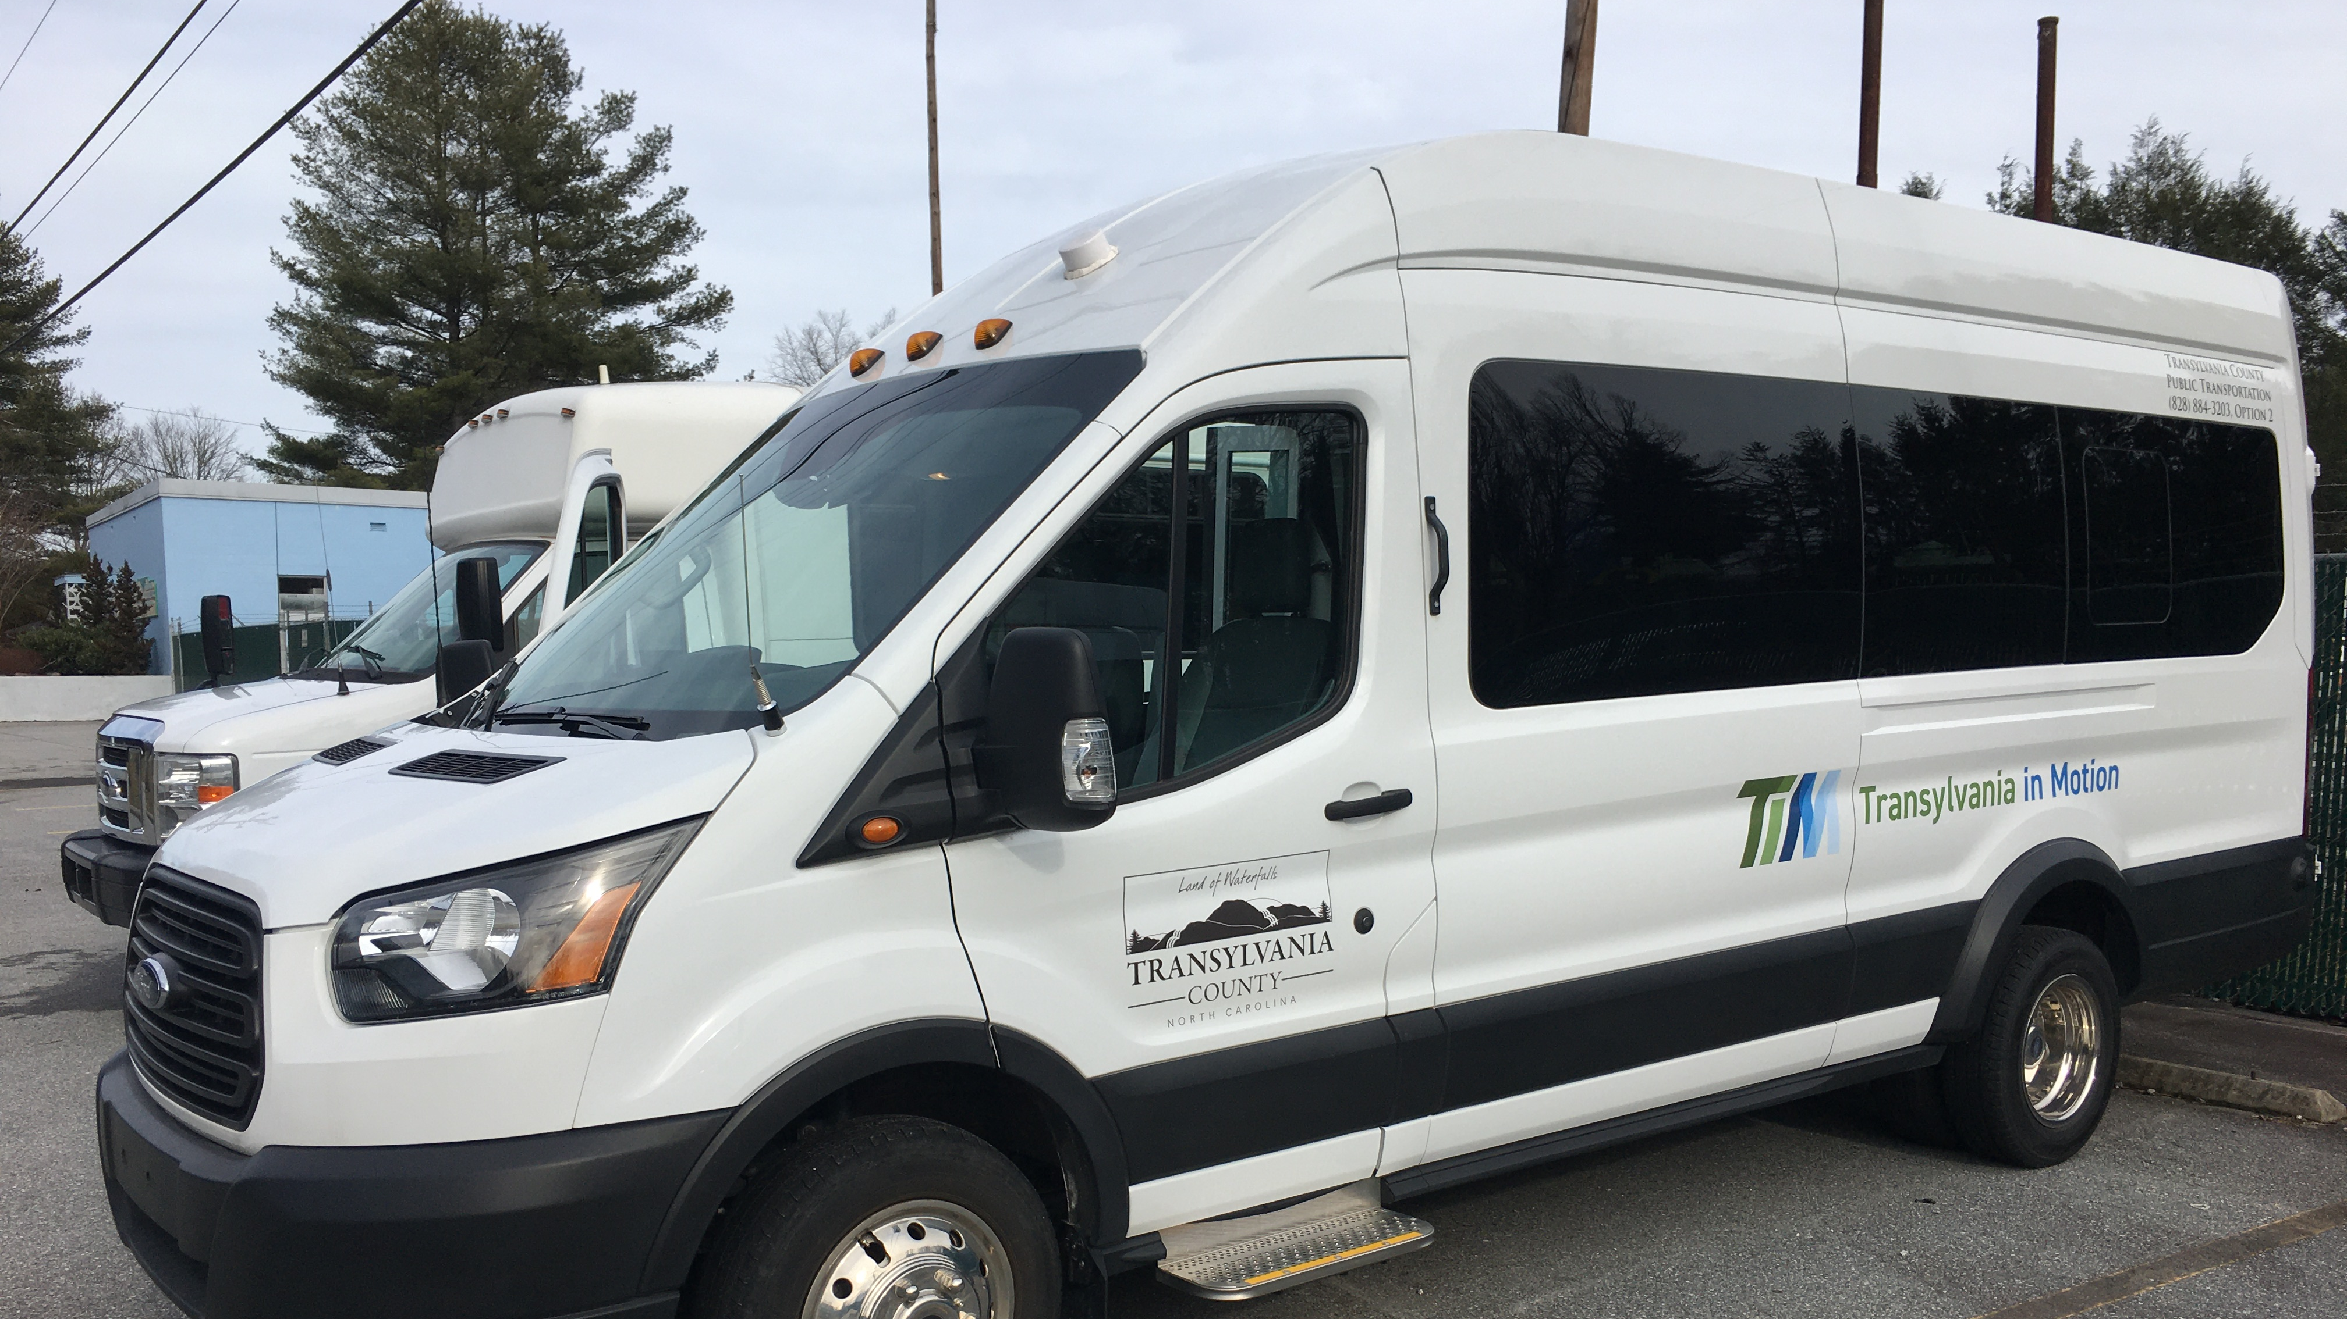
Transportation Advisory Board
November 13, 2024

Slide 2
I. Welcome

Slide 3
II. Agenda Modifications
Add Van Driver Highlight to Consent Agenda

Slide 4
III. Consent Agenda
August 14, 2024 Meeting Minutes

Slide 5
III-B. Transportation Updates
Transportation in the aftermath of Helene
Silver Squirrel Update
Increasing Advertising via Radio Ads

Slide 6
IV-B. Van Driver Highlight
Eugene “Gene” Evans

Slide 7
V. Election of Chair-Vice Chair

Slide 8
VI. Q1 FY25 Operational Statistics

Slide 9
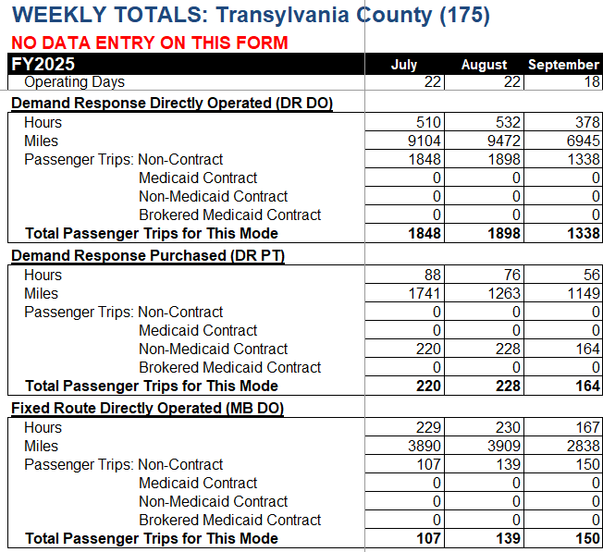
V-A. Q-1 FY25 Transportation Operational Statistics
Higher than FY24
DR Van Riders
Cab Riders
FR Van Riders

Slide 10
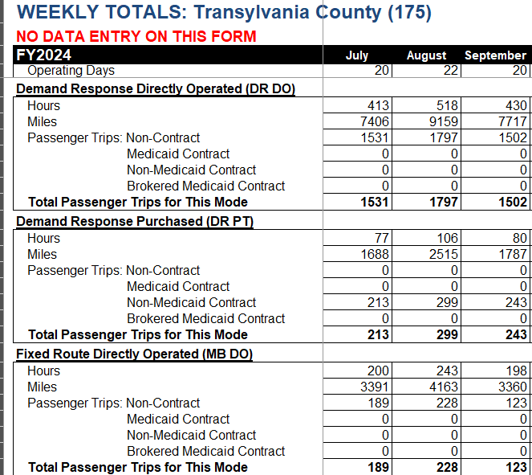
Q-1 FY24 Transportation Operational Statistics
DR Van Riders
Cab Riders
Higher than FY25
FR Van Riders

Slide 11
Fixed Route Monthly

Slide 12
Demand Response

Slide 13
VI-B. Unified Grant Application and ROAP Update

Slide 14
VI-C. Fixed Route Re-Routing Update

Slide 15
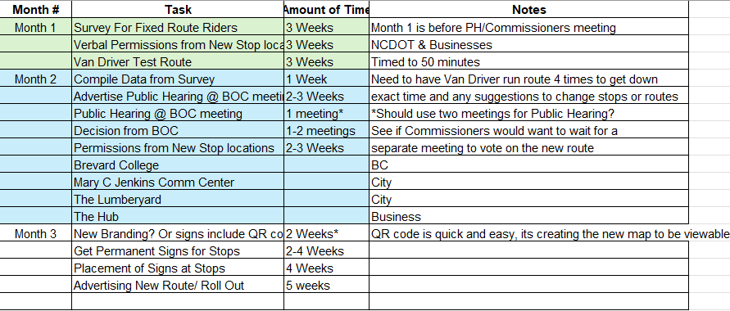
VI-C. Fixed Rerouting Summary
Please see below the schedule and summary of making changes to the Fixed Route.

Slide 16
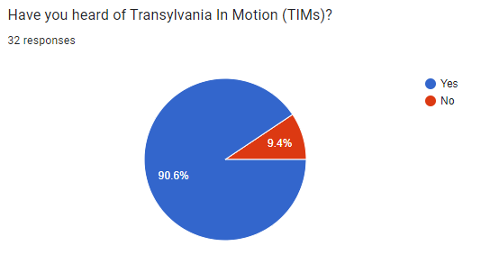
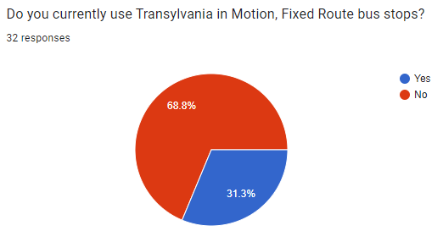
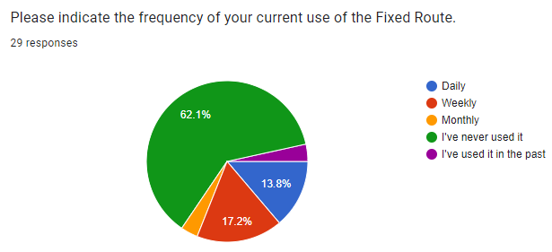

Slide 17
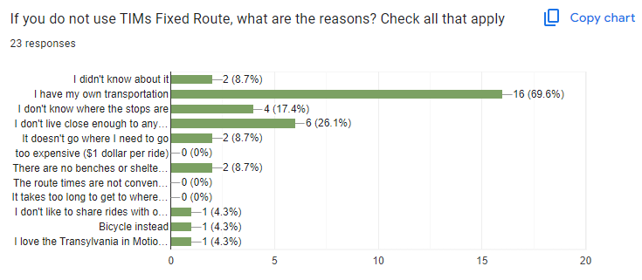
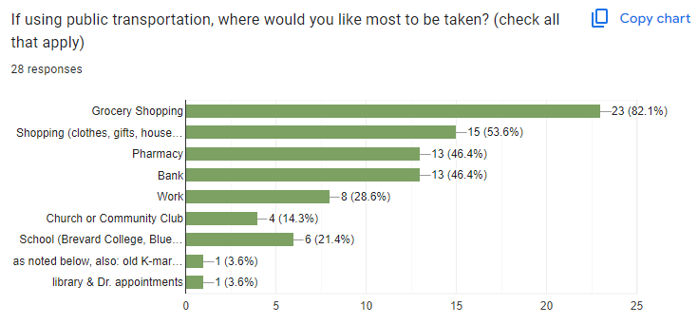

Slide 18
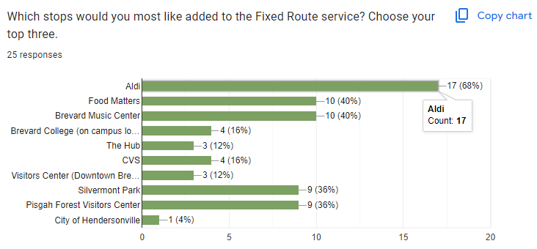
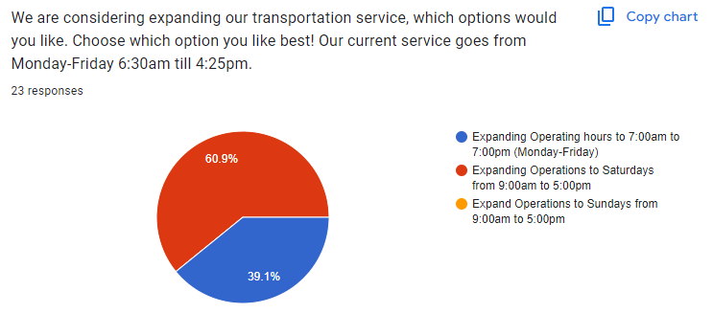

Slide 19
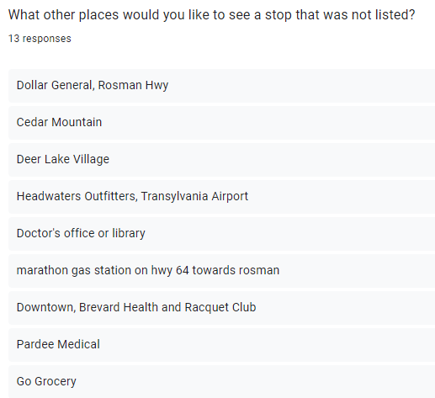
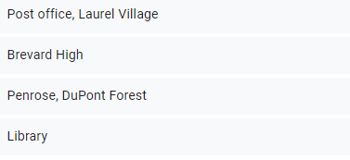

Slide 20
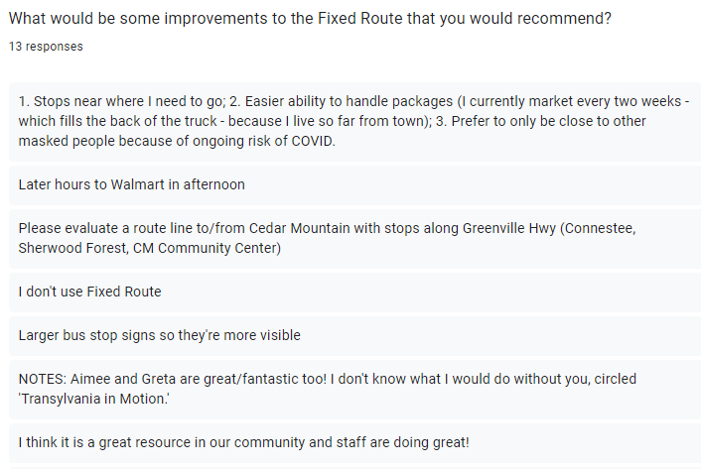
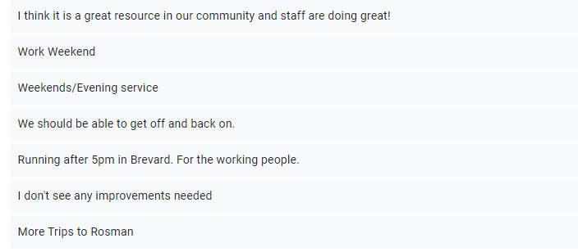

Slide 21
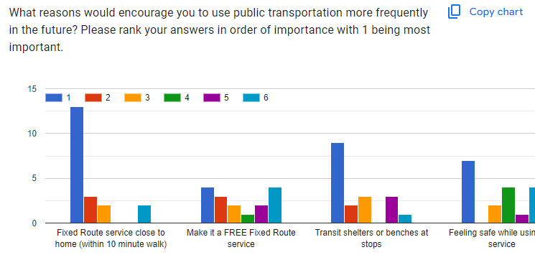
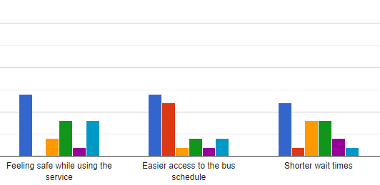

Slide 22
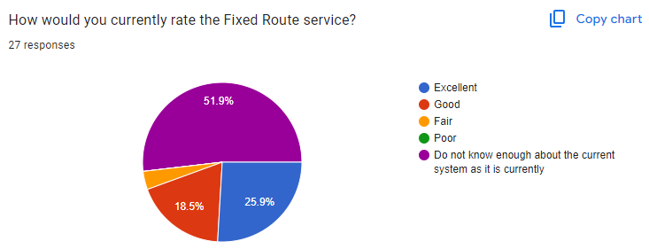
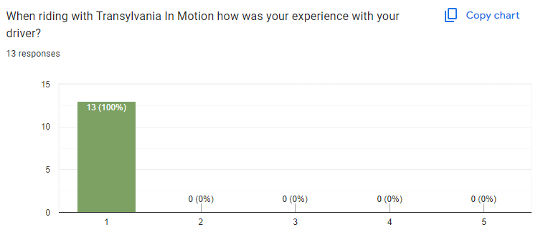

Slide 23
VI-C. Fixed Rerouting Report/Next Steps
https://docs.google.com/forms/d/1hRy4CF_Z9aIPbPhQsbleqOLjcXoLZHFy2M5JCnoMlAQ/edit#responses

Slide 24
VI-D. Land of Sky RPO Update
Vicki Eastland

Slide 25
New Business

Slide 26
VII-A. TAB Meeting Date Discussion
https://docs.google.com/forms/d/155lFY5hghTw4snWJnbEvQ3Ab-NURQtHjNx3BcaZWtvw/edit#responses

Slide 27
VI. Public Comment
15-Minute Time limit (speakers are held to three minutes)

Slide 28
VII. Board Members Comments

Slide 29
Thank you for attending
Next TAB meeting will be on ??????, in the Large DSS Conference Room, 2nd Floor.

