Slide 1
Transylvania County
Planning Board Meeting | July 2024

Slide 2
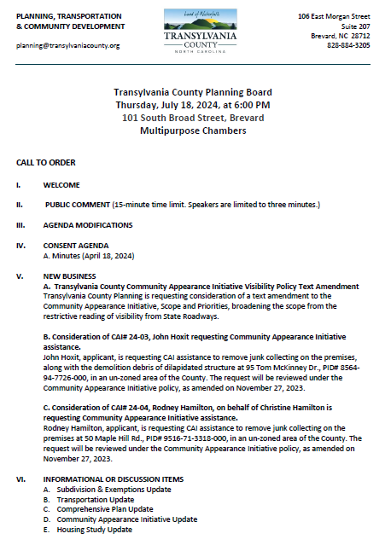
Transylvania County Planning Board

Slide 3
Public Comment

Slide 4
Agenda Modifications

Slide 5
Consent Agenda

Slide 6
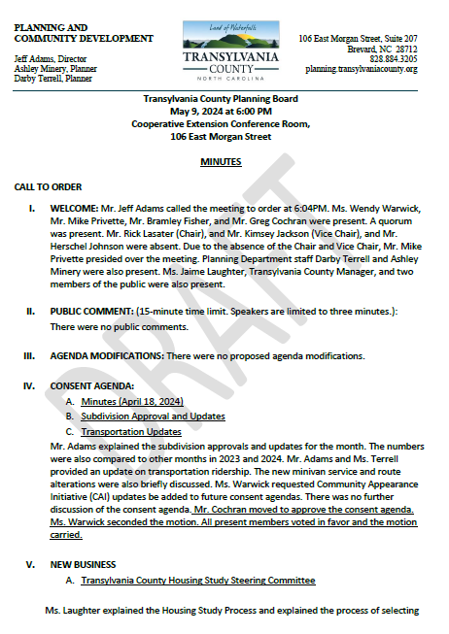
Minutes
May 9, 2024
Consent Agenda

Slide 7
Old Business

Slide 8
New Business

Slide 9
A. Community Appearance Initiative: Visibility Policy Text Amendment

Slide 10
Purpose
Consideration of proposed text amendment to the Transylvania County Community Appearance Initiative (CAI) Policy’s Scope and Priorities:
Current Language
Visibility Policy Text Amendment

Slide 11
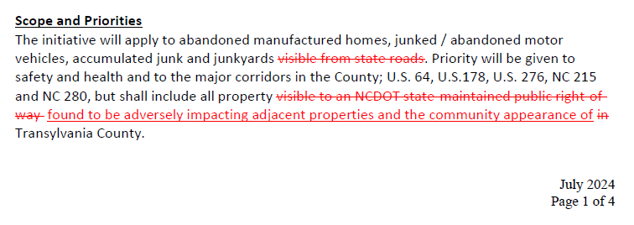
Proposed Language
Visibility Policy Text Amendment

Slide 12
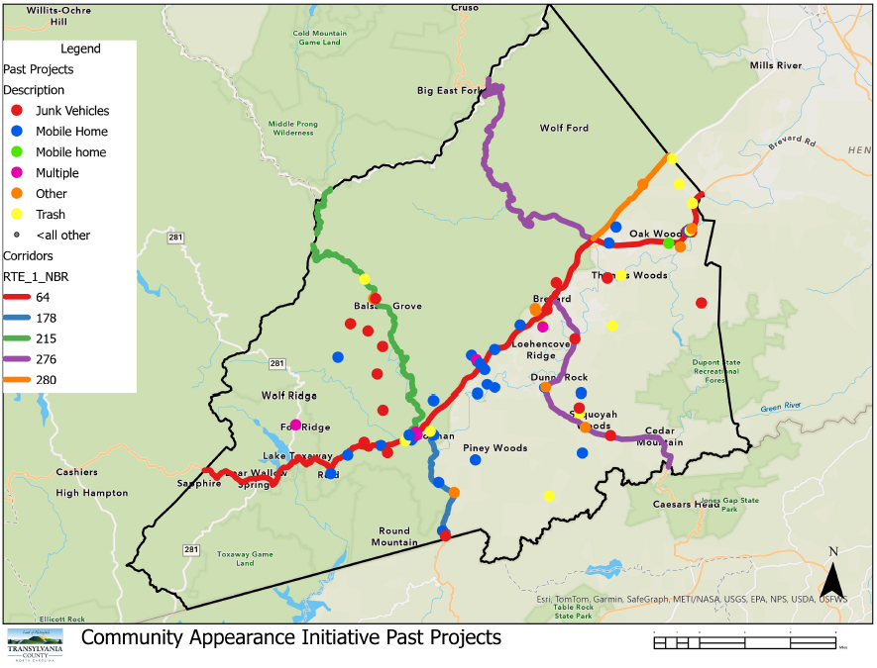
Previous CAI Cases
Visibility Policy Text Amendment

Slide 13
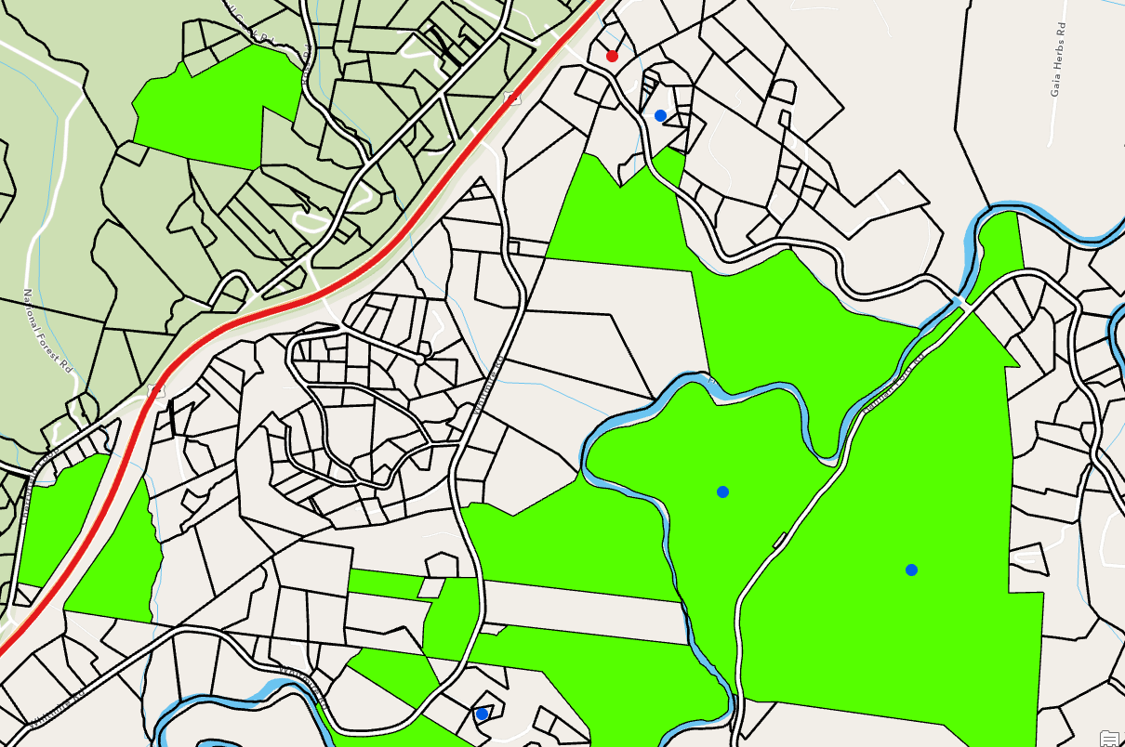
Hannah Ford Rd CAI Cases
Visibility Policy Text Amendment

Slide 14
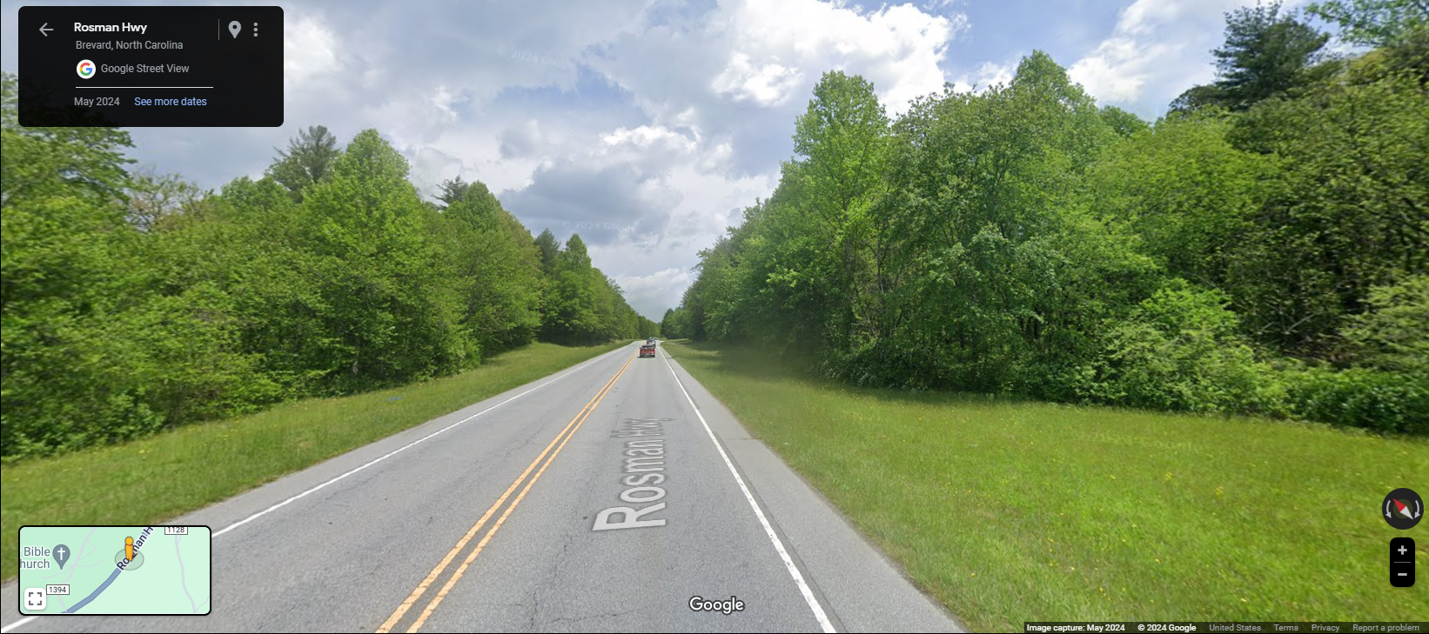
Hannah Ford Rd CAI Cases
Visibility Policy Text Amendment

Slide 15
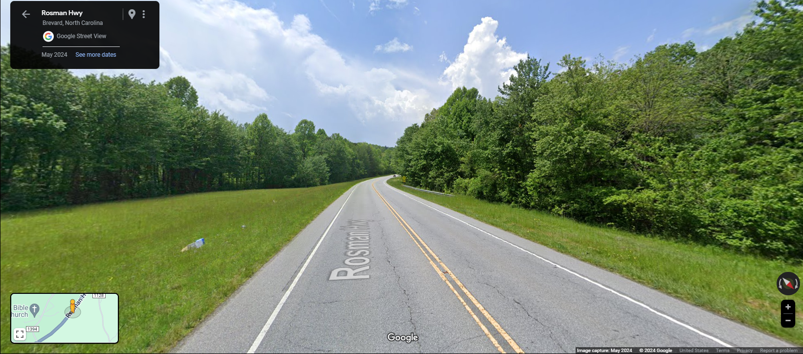
Hannah Ford Rd CAI Cases
Visibility Policy Text Amendment

Slide 16
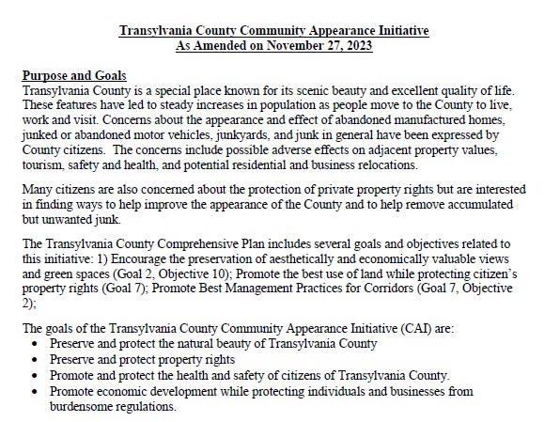
Goals
Visibility Policy Text Amendment

Slide 17
ReLaunch
Visibility Policy Text Amendment

Slide 18
Action
Visibility Policy Text Amendment

Slide 19
B. Hoxit CAI# 24-03

Slide 20
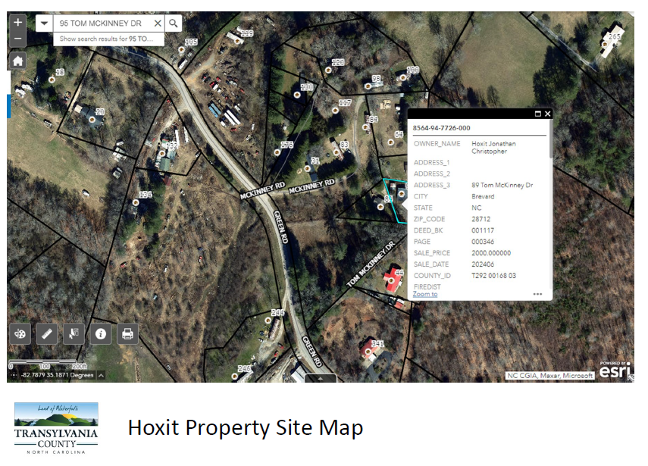
Staff Report
CAI# 24-03 Hoxit

Slide 21
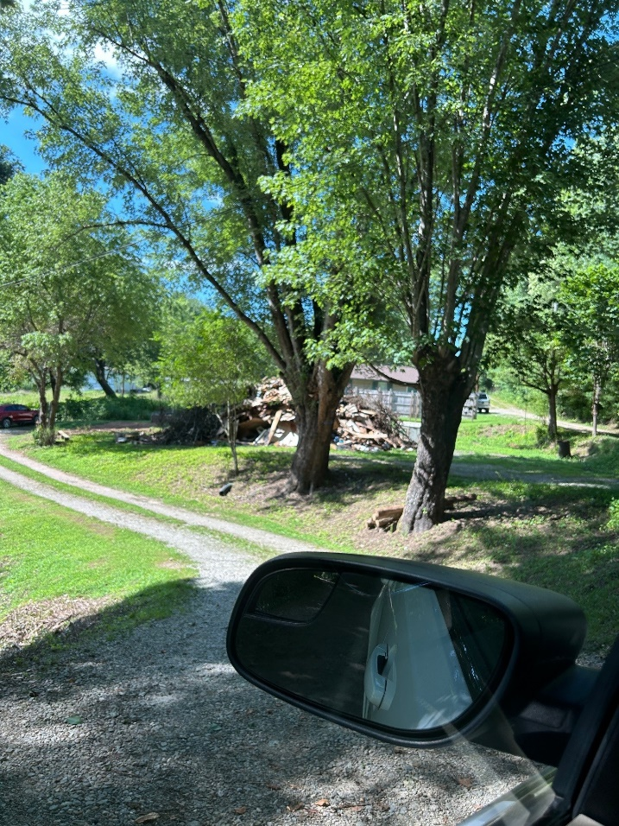
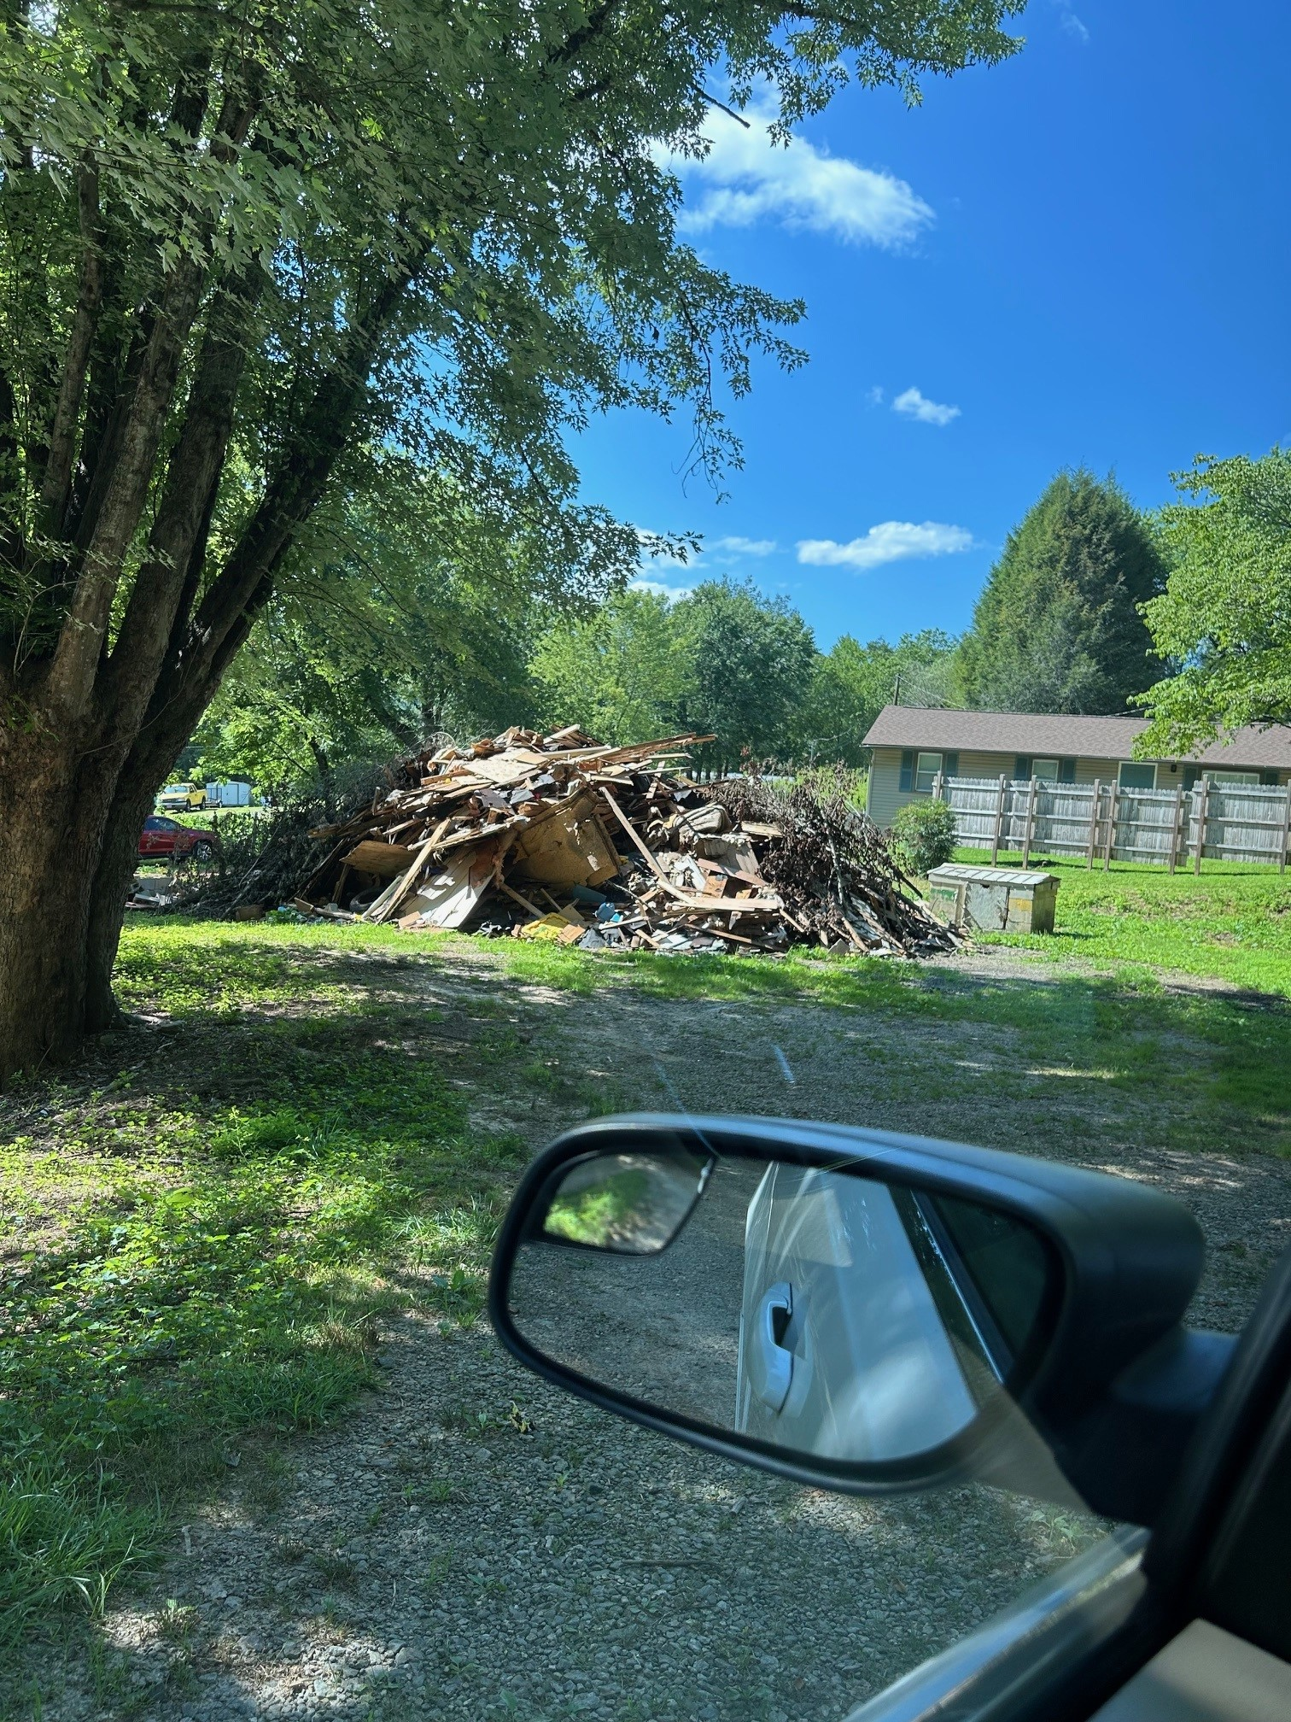
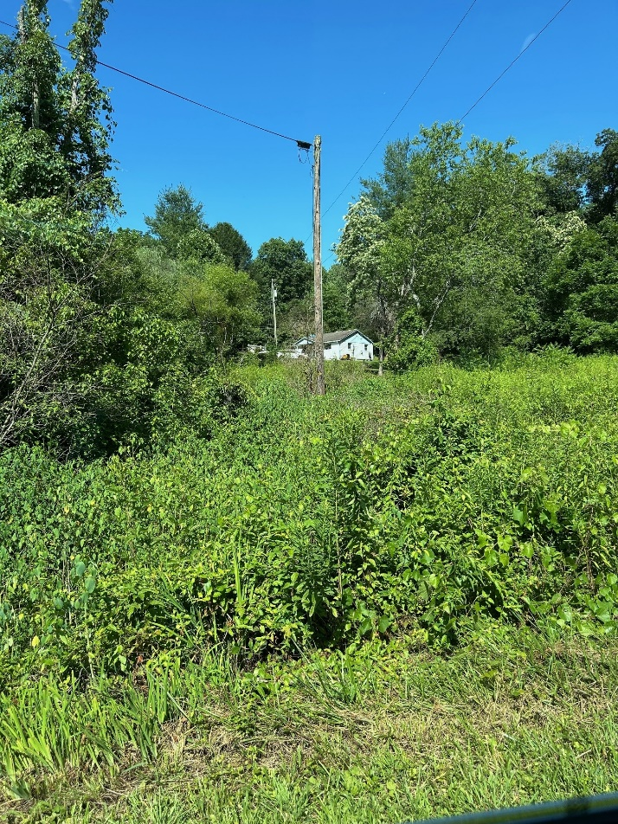
Staff Report
CAI# 24-03 Hoxit

Slide 22
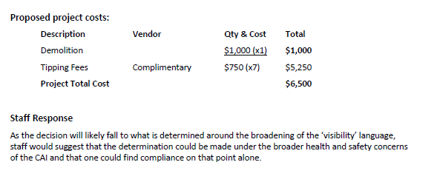
Staff Report
CAI# 24-03 Hoxit

Slide 23
C. Hamilton CAI# 24-04

Slide 24
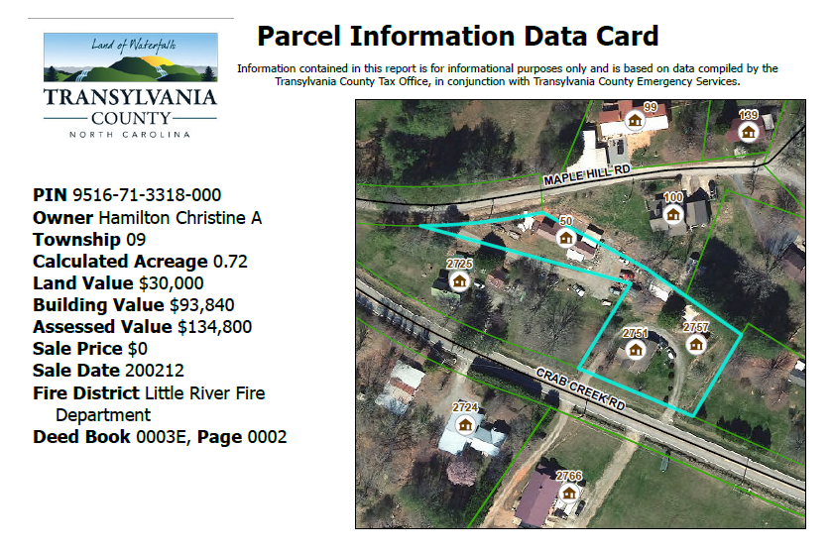
Staff Report
CAI# 24-04 Hamilton

Slide 25
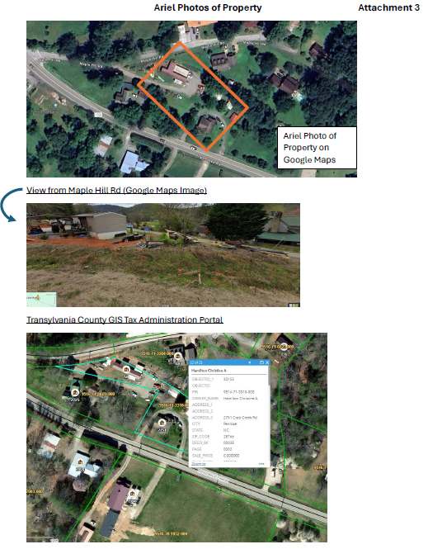
Staff Report
CAI# 24-04 Hamilton

Slide 26
Staff Report
CAI# 24-04 Hamilton

Slide 27
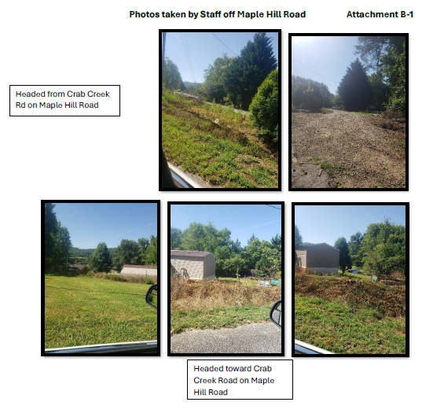
Staff Report
CAI# 24-04 Hamilton

Slide 28
Informational & Discussion Items

Slide 29
A. Subdivision Approval & Update
May 9, 2024- July 17, 2024
Subdivisions
9 Total
15 New lots created
Subdivision Exemptions
23 Total
1.1 Recombination- 15
1.9 Lot line adjustment- 6
Consent Agenda

Slide 30
B. Transportation Update
139
Average: YR22: 134, YR23:177
Average Monthly Riders DR: 1,799 (FY24)
2nd Highest Ridership per month in last 4 years
FY23 Highest 1,888 riders
Consent Agenda

Slide 31
C. Comprehensive Plan Update

Slide 32
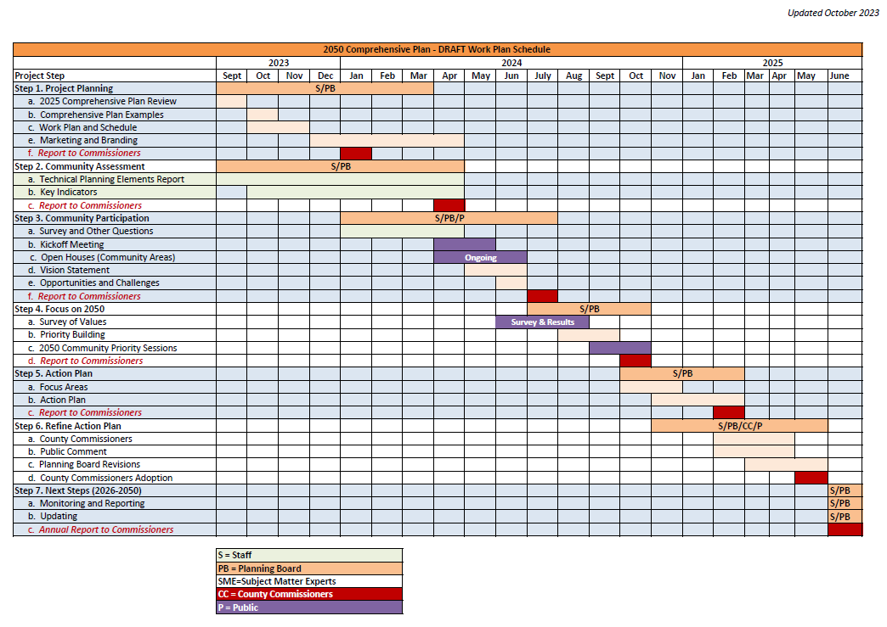
Comprehensive Plan: Outreach

Slide 33
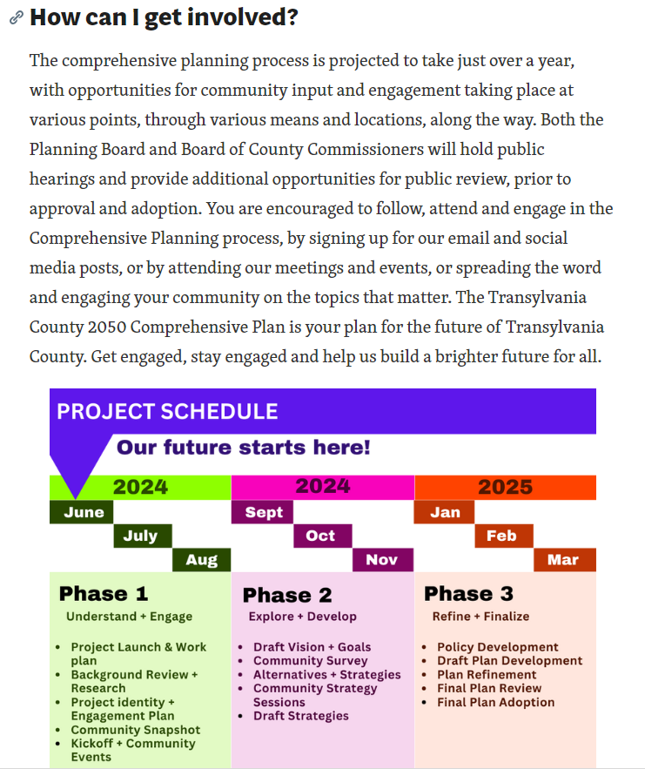
Comprehensive Plan: Outreach

Slide 34
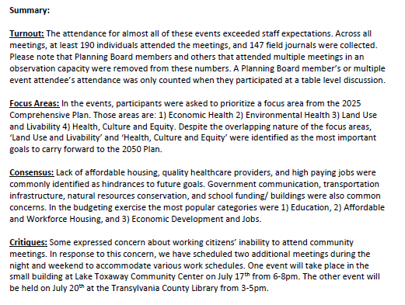
Comprehensive Plan: Summary

Slide 35
D. Community Appearance Initiative Update

Slide 36
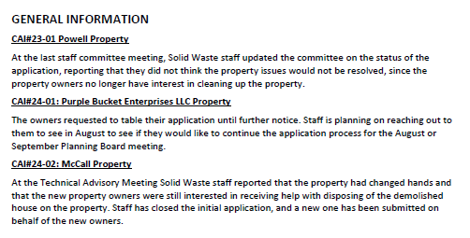
Summary
Budget
FY 24/25 $20,000 TDA $20,000 TCO Match = $40,000
Rolled over to FY 25/26
FY 24/25 Released = $1,000
FY 24/25 Expended = $ 0
Community Appearance Initiative Update

Slide 37
E. Housing Study Update

Slide 38
Summary
Housing Study Update

Slide 39
Public Comment

Slide 40
Board Members’ Comments

Slide 41
Adjournment

