Slide 1

Transylvania County's Transportation Advisory Committee
Regular Meeting
July 9, 2024 at 6:00 PM
County Commissioners Chamber at 101 South Broad Street, Brevard NC 28712

Slide 2
Agenda
Welcome/Organizational
I/II
Public that is interested in speaking, please sign in at the front, thank you.
Public Comment
IV
Consent Agenda
V
Presentation
VI
Old Business
VII

Slide 3
Organizational Meeting
1. Election of Chair
2. Election of Vice Chair
Need a candidate or candidates for Chair
  A motion needs to be made and a second, then a vote and approval
Need a candidate or candidates for Vice Chair
  A motion needs to be made and a second, then a vote and approval

Slide 4
B. Review of Responsibilities
Transportation Advisory Committee (TAC) is an advisory board to the Transylvania County Commissioners, with representation from the City of Brevard and the Town of Rosman. TAC is responsible for the following:
  Reviews current road conditions.
  Advises the County Board of Commissioners and the NC Department of Transportation (DOT).
  Participates in transportation project prioritization in Transylvania County as part of NC’s State Transportation Improvement Program (STIP). (Division 14)
  Participates in the development of the County’s Comprehensive Transportation Plan every five years to ten years.
  Considers alternate transportation projects including pedestrian, bicycling, and greenway trails.

Slide 5
Public Comment
15-minute time limit
For those who wish to speak, please sign in on the sheet at the front.
Each speaker is limited to 3 minutes
​

Slide 6
3 Minutes
2 Minutes
1 Minute
30 Seconds
Time Complete
Please end comments
Thank you!

Slide 7
Cascade Lake Road-US 276 (Greenville Hwy)

Slide 8
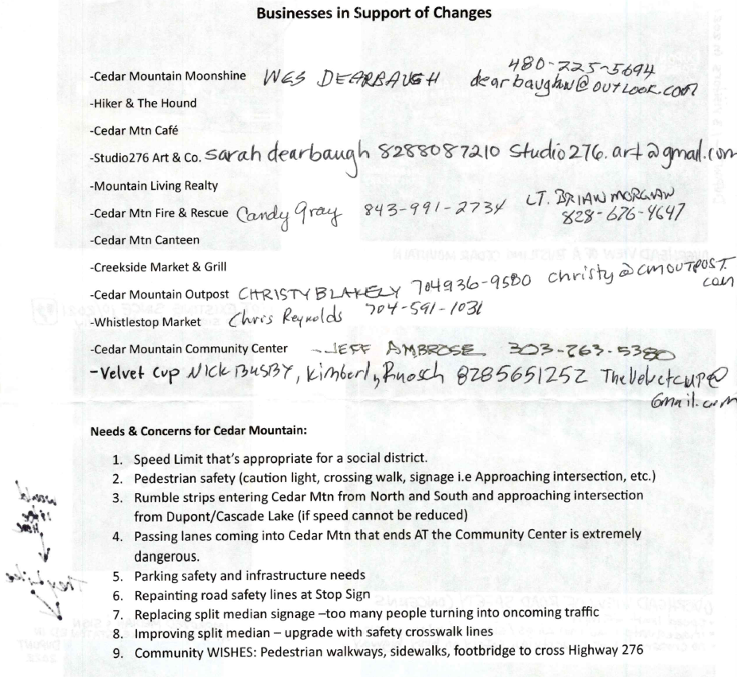
Cedar Mountain Business Handout from Meeting with Commissioner Chapman and Vicki Eastland, Land of Sky RPO

Slide 9
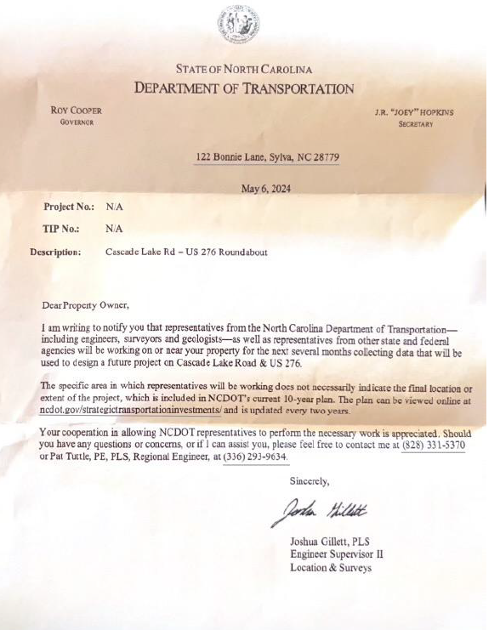
Cedar Mountain Residents Letter

Slide 10
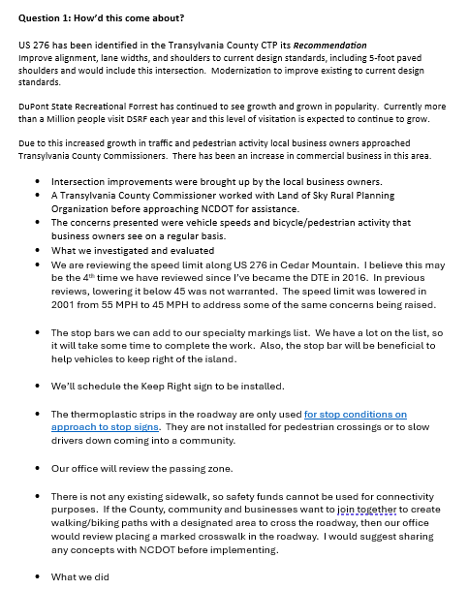
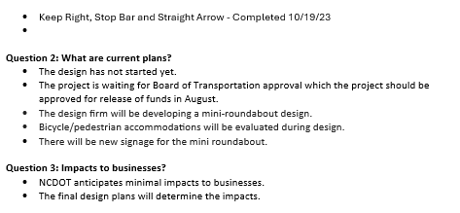
NCDOT Report on Cascade Lake Road Intersection
*Data from DuPont State Recreational Forest Data and statistics (Information located in NCDOT Report)

Slide 11
NCDOT Preliminary Concept of Compact (mini) Roundabout

Slide 12
Citizen advisory council training
Notes:
Welcome! On behalf of the Transylvania County Board of Commissioners and County staff, we are pleased you are serving as a member on one of the County’s many citizen advisory councils. The operation of Transylvania County government is a shared responsibility of elected officials, staffs and many citizens who serve voluntarily on various boards, commissions, committees and councils. The County is best served when there is broad representation of citizens and interests on the various citizen advisory councils.

Slide 13
County Government
Transylvania County operates under the County Manager form of government
Board of Commissioners comprised of five members who are elected by the people and serve four-year staggered terms
Board of Commissioners is the legislative and policymaking body for Transylvania County
Board of Commissioners is responsible for establishing general policies for the County, enacting ordinances, resolutions, and orders, establishing the annual budget, authorizing contracts on the County’s behalf, and appointing the Manager, Attorney, Tax Administrator and Clerk, and members of the various citizen advisory councils
Notes:
First I want to give a brief overview of your County government.
Transylvania County operates under the County Manager form of government. The County Manager carries out the directives and policies established by the Board of Commissioners and manages the day-to-day operations of the County.
The Board of Commissioners is comprised of five members who are elected by the people in November of even-numbered years. Commissioners serve four-year staggered terms. None of the members of the Board of Commissioners are full-time officials and they may retain their positions in their chosen professions. The members shall receive for their services a salary as fixed and as provided by law.
The Board of Commissioners is the legislative and policymaking body for Transylvania County, and is the final authority on most matters relating to the County. The Board of Commissioners is responsible for establishing general policies for the County, enacting ordinances, resolutions, and orders, establishing the annual budget, authorizing contracts on the County’s behalf, and appointing the County Manager, County Attorney, Tax Administrator, and the County Clerk, and members of the various citizen advisory councils. The Commission Chair serves as the official and ceremonial representative of County government and presides at all meetings and executes ordinances and various other documents.
The County Manager acts similar to a CEO of a company.

Slide 14
County Government
  The current County Commission members are:
  Jason Chappell, Chair
  Jake Dalton, Vice-Chair
  Teresa McCall
  Larry Chapman
  Chase McKelvey
Notes:
The current County Commission members are:
Mike Hawkins, Chair
Page Lemel, Vice-Chair
Jason Chappell
Jake Dalton
David Guice

Slide 15
Citizen Advisory Council
Any committee, board, commission, council or other similar group established by statute or authority, comprised of citizen volunteers who advise the local government on community issues and needs.
Notes:
As a citizen member, you serve in an advisory capacity to the Board of Commissioners, performing a valuable service by addressing community issues and needs. The decision-making process in local government can be a long process of research, information on pros and cons of options, cost, legalities, etc. Committees may take time to study an issue over multiple meetings to arrive at a recommendation for Commissioners.
We look forward to your continued contribution as we work together to provide efficient county services, responsive to local needs and expectations. Your valuable knowledge and expertise are essential as we prepare for the many challenges ahead.

Slide 16
Citizen Advisory Councils-Eligibility
Any resident of Transylvania County over the age of 18 is eligible to be appointed to a CAC
Exceptions to the residency requirements are noted separately for individual boards where this applies
No resident of Transylvania County may serve in more than two appointed positions of Transylvania County government
No resident may serve more than two consecutive full terms in any one position
Notes:
Any resident of Transylvania County over the age of 18 is eligible to be appointed where such appointment is not prohibited by State statute. Exceptions to the residency requirement are noted separately for individual boards where this applies. A resident is defined as someone who lives in Transylvania County the majority of the year and claims Transylvania County as their domicile for legal purposes.
All appointments will be made according to the applicable statute, ordinance, resolution or policy that created the specific Citizen Advisory Council.
No resident of Transylvania County may serve in more than two (2) appointed positions of Transylvania County government unless exempted by nature of the position he or she may hold in governmental service.
No resident may serve more than two (2) consecutive full terms in any one position. The preferred length of terms is considered to be three years, unless specified otherwise, with terms staggered so that appointments are made each year. An individual whose initial appointment was to fill less than 50% of an unexpired term shall be eligible to serve two full terms. An individual whose initial appointment was to fill more than 50% of an unexpired term shall be eligible to serve only one full term.
This policy may be waived if the Board of Commissioners determines that the removal of a number of individuals made ineligible by this policy would be detrimental to the functioning of that Citizen Advisory Council.

Slide 17
Citizen Advisory Councils
Abandoned Cemeteries Board
Agricultural Advisory Board
Blue Ridge Community College Board of Trustees
Board of Equalization and Review
Board of Health
Brevard Board of Adjustment and Appeal (City)
Brevard Planning and Zoning (City)
Child Fatality Prevention Team/Community Child Protection Team
Area & County Councils on Aging
Joint Historic Preservation Commission
Jury Commission
Juvenile Crime Prevention Council
Library Board of Trustees
Nursing and Adult Care Advisory Committee
Parks and Recreation Commission
Personnel Board
Planning Board/Board of Adjustment
Social Services Board
Tourism Development Authority
Transportation Advisory Committee
Transylvania Natural Resources Council
Workforce Development Board
Notes:
The Board of Commissioners has established a number of citizen advisory councils to review county programs, projects and community issues. These groups provide greater community participation and input into local government and facilitate quality decisions by the Board of Commissioners. They help provide direction for the allocation of funds, the provision of human services, the protection of citizens, property, and our natural resources, and for other worthy services. Therefore, the input of the citizen advisory councils is vitally important. Although citizen advisory councils make recommendations for the allocation of funds, they do not typically have a budget.

Slide 18
Citizen’s Role and Authority
Advise the Board of Commissioners in the determination of County policies and procedures
Facilitate public discussion
Members should stay informed on subjects of interest to their specific CAC
Attendance is a fundamental responsibility
Notes:
Citizen advisory Councils have a primary role – to advise the Board of Commissioners in the determination of county policies and procedures. Citizen advisory councils facilitate public participation. Despite differing tasks conducted by citizen advisory councils, they share some basic responsibilities. Members should stay informed on subjects of interest to their specific citizen advisory council. Conscientious attendance is also a fundamental responsibility, as irregular attendance lessens one’s ability to study all aspects of items under consideration.

Slide 19
Citizen’s Role and Authority
Not involved in the administration or operation of County departments
May not direct staff to initiate programs
May not conduct studies or establish official policies without the approval of the Board of Commissioners
Notes:
County staff members are available to provide general staff assistance to citizen advisory councils. However, citizen advisory councils are not involved in the administration or operation of County departments. Members may not direct staff to initiate programs or allocate funds. Citizen advisory councils may not conduct major studies, or establish official policy without the approval of the Board of Commissioners.

Slide 20
The Role of Citizen Advisory Councils
Provides input to the Board of Commissioners
Opens additional lines of communication between general public and Board
Does not determine or establish County policy or administrative action
Benefits:
  Focuses attention on specific issue areas
  Encourages citizen participation
  Provides a viewpoint from community neighborhoods
  Makes recommendations based on thorough and in-depth analysis of alternatives from a citizen’s perspective
Notes:
Members of the various citizen advisory councils provide input to the Board of Commissioners, advising and assisting the Board in special issue areas. Opening additional lines of communication between the general public and the Board, such groups help assure that County government is responsive to citizens. While each citizen advisory council makes recommendations to the Board of Commissioners, they do not determine or establish County policy or administrative direction. Benefits of citizen advisory councils include: focusing attention on specific issue areas, encouraging citizen participation, providing a viewpoint from community neighborhoods, and making recommendations based on thorough and in-depth analysis of alternatives from a citizen’s perspective.

Slide 21
Guidelines for Citizen Members
Present views and recommendations representing the CAC as a body, not as the individual’s personal views
Public statements should not include promises that may be construed to be binding to the Board, County staff or CAC
CAC actions are recommendations; final action will be taken by the Board of Commissioners
Each member should represent the overall “public good” and not an exclusive group or special interest
Notes:
Individual committee members should present views and recommendations representing the citizen advisory council as a body, not as the individual’s personal views. Members expressing views not approved by the majority of a citizen advisory council should indicate their opinions are given as “private citizens”. Individual opinions must be identified as such.
Public statements should not include promises that may be construed to be binding on the citizen advisory council, Board of Commissioners or County staff. When making a public statement, members should indicate that citizen advisory council actions are recommendations only and that final action will be taken by the Board of Commissioners.
Citizen advisory council members may be selected on the basis of representing defined groups; however, each member should represent the overall “public good” and not an exclusive group or special interest.

Slide 22
Guidelines for Citizen Members
Work to establish a good relationship with other citizen members
Familiarize themselves with County government, the administrative organization and CAC to which he or she has been appointed
Always show respect for other individuals’ viewpoints
Allow other members adequate time to present their views
Recognize new members and make them feel welcome
Be open and honest
Minimize political opinions among members
Notes:
Citizen advisory council members should strive to:
Work to establish a good relationship with other citizen members. The success or failure of a council’s efforts may be dependent upon the degree of cooperation evident among the individual members of the body.
Familiarize themselves with County government, the administrative organization and the citizen advisory council to which he or she has been appointed in order to gain the perspective necessary to make informed judgments and recommendations
Always show respect for the other individuals’ viewpoints
Allow other members adequate time to present their views
Recognize new members and make them feel welcome
Be open and honest
Minimize political opinions among members

Slide 23
Roles and Responsibilities
In order to conduct official business and vote on matters before the CAC, there must be a quorum of members in attendance
Each CAC shall elected a presiding officer
The chair is responsible for developing agendas, running the meeting, and providing leadership to the CAC
Members will also elect their own vice-chair who will serve in the absence of the chair
The CAC may elected other officers as it deems necessary
Appointees are expected to attend all meetings possible
Notes:
In order to conduct official business and vote on matters before the citizen advisory council, there must be a quorum of members in attendance. A quorum for a meeting shall consist of one more than half of the voting members unless specified otherwise.
Each Citizen Advisory Council shall elect from its membership a presiding officer who shall be referred to as chairman, chairwoman, or chairperson, as determined appropriate by the Citizen Advisory Council, and such officer shall serve for one year. State statutes designate the chair for a few boards. The chair is responsible for developing agendas, running the meeting, and providing leadership to the Citizen Advisory Council. The Citizen Advisory Council may elect other officers as it deems necessary and such offices shall be set forth in the rules of procedure adopted by the Citizen Advisory Council.
Members will also elect their own vice-chair who will serve in the absence of the chair.
Appointees are expected to attend all meetings possible.
If an appointee has unexcused absences which constitute more than 25% of the Citizen Advisory Council meetings in any year which he/she is required to attend pursuant to his/her appointment, he/she is obligated to resign.
Excused absences are defined as absences caused by events beyond one’s control. If the individual refuses to resign, he/she may be dismissed by action of the Board of Commissioners subject to State or local law. A year is to be defined as a twelve-(12) month period beginning on the date of appointment.

Slide 24
North Carolina Open Meetings Law
All meetings of any CAC must be public meetings and open to the public at all times
The CAC must provide reasonable notice of all such meetings so as to allow the public a chance to be present
The minutes of any CAC must be recorded in a timely manner; they do not need to be verbatim; however, they should briefly summarize the events of the meeting
Notes:
The North Carolina Open Meetings Law guarantees all North Carolina residents a right of access to government meetings and records; it contains several basic requirements, which are most important for members of citizen advisory councils to familiarize themselves with.
Basic Requirements of the Open Meetings Law
All meetings of any citizen advisory council must be public meetings and open to the public at all times.
The citizen advisory council must provide reasonable notice of all such meetings so as to allow the public a chance to be present. Each CAC has a set meeting date, time and location and that information is listed in the local newspaper under events and on the County’s website calendar and CAC webpage under the respective CAC. Should the meeting date, time or location deviate from the normal schedule, notice would need to be made to the public.
The minutes of a meeting of any citizen advisory council must be recorded in a timely manner. The minutes do not need to be verbatim; however, they should briefly summarize the events of the meeting.

Slide 25
North Carolina Open Meetings Law
Name of Citizen Advisory Council
Meeting Minutes
Date and time meeting convened and the meeting place
Type of meeting (regular or special)
The calling to order by the chairperson
The roll call, including a list of the names of the members present and absent
A listing of others in attendance at the meeting
Approval of prior meeting minutes
Substance of all matters proposed, discussed or decided and any motions made and voted upon by members
If a vote is taken, the minutes must reflect each members’ vote on the matter
The substance of remarks made by members of the general public who address the CAC
Any future meeting dates, times and locations
The time of the adjournment
The name of the individual taking the minutes
Notes:
In order to comply with State law and to standardize the preparation and content of minutes for all citizen advisory councils, the Clerk to the Board has provided sample minutes in this presentation. Minutes of the meetings are to be submitted to the Clerk to the Board as soon as possible so as to provide accurate record maintenance of all County meetings. Please use the following guideline when preparing the minutes. Any questions regarding the minutes or their preparation should be referred to the Clerk to the Board.
The minutes should be signed by the person taking the minutes and the council chairperson. Depending on the citizen advisory council, back up material (including minutes of prior meeting and agenda of the current meeting) should be provided at least a week before the meeting. This is not always possible; the information should be provided as soon as possible prior to the meeting.

Slide 26
North Carolina Open Meetings Law
The Open Meetings Law is applicable to elected and appointed citizen advisory councils
Any gathering, whether formal or informal, of a majority of members of a CAC can be in violation of the NC Open Meetings Law
Communications That May Be In Violation:
  Written communications where comments are circulated to members
  Telephone conversations among the members regarding the issues to be voted upon or to be discussed at future citizen advisory council meetings
  Use of computers or other devices to convey messages or reports to other members
Notes:
The Open Meetings Law is applicable to elected and appointed citizen advisory councils.
Any gathering, whether formal or informal, of a majority of members of a citizen advisory council can be in violation of the North Carolina Open Meetings Law particularly if they discuss anything that may come up before the citizen advisory council in the foreseeable future. Even if a majority of the members of a citizen advisory council do not physically meet, but communicate through another means, they may be in violation of Open Meetings Law.
Communications That May Be In Violation
Written communications where comments are circulated to members
Telephone conversations among members regarding issues to be voted upon or to be discussed at future citizen advisory council meetings
Use of computers or other devices to convey messages or reports to other members

Slide 27
Public Records Law
The Public Records Law determines what is to be considered a public record
Any document such as agendas, back-up material, and minutes of the meetings would be open to public inspection
NCGS defines public records as not only documents and papers, but also “maps, books, photographs, films, sound recordings, magnetic and other tapes, electronic data processing records, (and) artifacts…regardless of physical form or characteristics
NCGS further defines public records as the items made or received pursuant to law or ordinance in connection with the transaction of public business
Notes:
The Public Records Law determines what is to be considered a public record. Any documents such as agendas, back-up material, and minutes of the meeting would be open to public inspection.
As a citizen advisory council member, one must disclose and submit as part of the official record any correspondence received, regardless of the physical form. North Carolina General Statutes has a very broad definition of “public record”, generally unlimited by the form of the material in question or by the circumstances under which it was received or created. The statute begins by including within the definition not only documents and other papers, but also “maps, books, photographs, films, sound recordings, magnetic or other tapes, electronic data processing records, (and) artifacts…regardless of physical form or characteristics.” The statute then goes on to state that “public record” means the listed items “made or received pursuant to law or ordinance in connection with the transaction of public business”.

Slide 28
Conflict of Interest (NCGS 160A-75)
The law requires that all CAC members disclose any financial interests they have, and they must abstain from participating in any matters before their CAC that may have an impact on their financial interest
CAC members are required to abstain from voting if a conflict of interest is involved
No member shall be excused from voting except upon matters involving a conflict of interest
Notes:
This law requires that all citizen advisory council members disclose any financial interests they have, and they must abstain from participating in any matters before their citizen advisory council that may have an impact on their financial interest. In effect, if a citizen advisory council member does business with a person coming before the citizen advisory council, it is essential for that member to not participate in the proceedings, or he/she will be in violation of the law. Additionally, pursuant to this law, members of citizen advisory councils are required to abstain from voting if a conflict of interest in involved; this means that they may not vote on any matter, which may have an impact on themselves, on a family member, or on someone who retains their service.
No member shall be excused from voting except upon matters involving a conflict of interest. In all other cases, a failure to vote by a member who is physically present and has not been excused by a majority vote of the remaining members present shall be recorded as an affirmative vote.
Citizen advisory councils share a responsibility under State law to operate in support of open meetings and public records laws and areas like conflict of interest. County staff will work to help you understand those responsibilities and act as a resource when questions arise.

Slide 29
Parliamentary Procedure
All proposals for action should be made by making a motion; only one motion can be before the CAC at one time
Before a motion may be discussed, a second to the motion is needed
To make any changes to the motion, a motion to amend is in order
To temporarily postpone a motion, usually to the next meeting, a motion to table the item to a date certain is in order
A motion to recess is needed when a recess (or intermission) for a short time is requested
A motion to adjourn occurs at the end of the meeting prior to all members leaving the meeting
Notes:
Robert’s Rules of Order is a good source for members of citizen advisory councils. The following are the most common rules, which should be used when making motions:
All proposals for action should be made by making a motion; only one motion can be before the citizen advisory council at one time.
Before a motion may be discussed, a second to the motion is needed.
To make any changes to the motion, a motion to amend is in order.
To temporarily postpone a motion, usually to the next meeting, a motion to table the item to a date certain is in order.
A motion to recess is needed when a recess (or intermission) for a short time is requested.
A motion to adjourn occurs at the end of the meeting prior to all members leaving the meeting.

Slide 30
Parliamentary Procedure
Motion | Description
To defer consideration | Defer substantive motion for later consideration at an unspecified time
Call for the previous question | Motion to end debate; not in order until there have been at least 20 minutes of debate and every member has had an opportunity to speak once
Refer to committee | May refer a substantive motion to a committee for its study and recommendations
Revive consideration | May revive consideration of any substantive motion earlier deferred
Reconsider | May vote to reconsider action on a matter; may only be made by a member who voted with the prevailing side
Rescind or repeal | May vote to rescind actions it has previously taken or to real items that it has previously adopted
Prevent reintroduction for 6 months | Motion shall be in order immediately following the defeat of a substantive motion
Renewal of motion | A motion that is defeated may be renewed at any later meeting unless a motion to prevent reconsideration has been adopted
Withdrawal of a motion | A motion may be withdrawn by the introducer at any time before it is amended or before the chair puts the motion to a vote, whichever occurs first
Notes:
Here are other motions which are part of parliamentary procedure.

Slide 31
Questions?
Thank you for attending!
Notes:
Twice a year we intend to make this training available. We are always open to suggestions on how to make it better.
A few items on the horizon are:
Annual reporting requirements for all CACs
To ensure better transparency, we intend to make the minutes of the CACs available online
We are working on how to best implement these practices.
Thank you all so much for attending today.

Slide 32
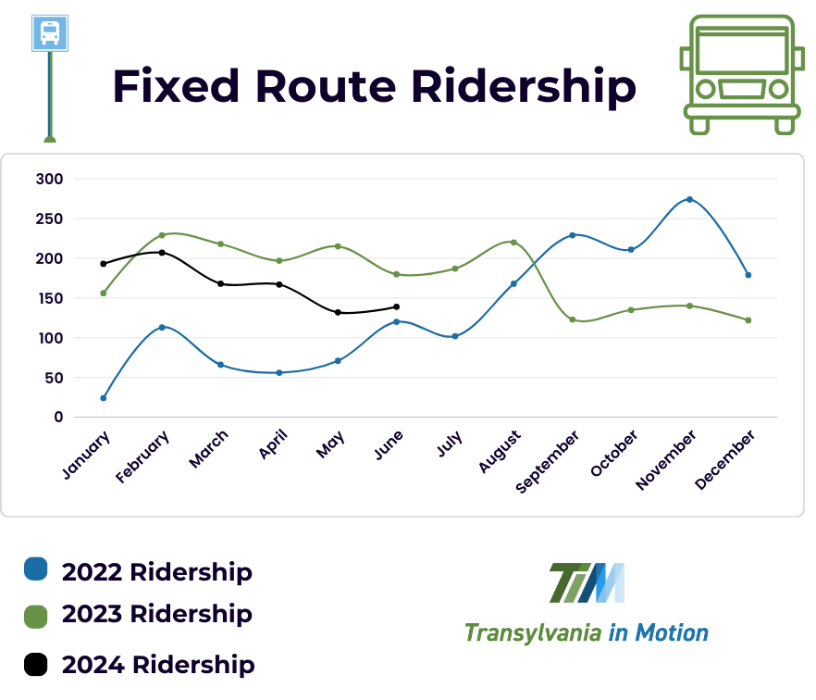
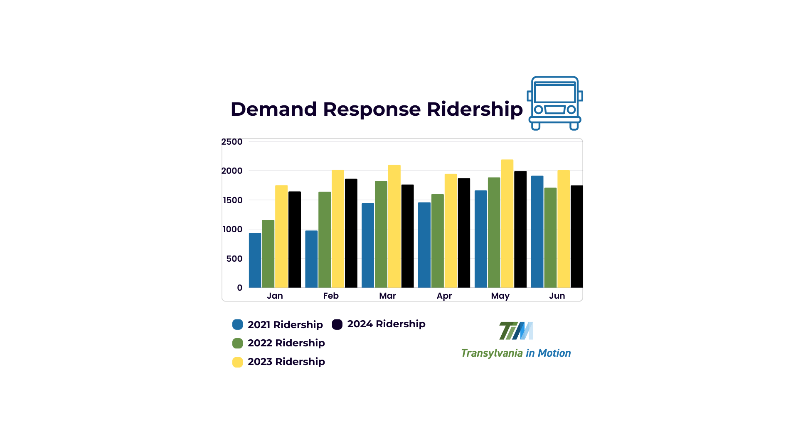
Consent Agenda
Minutes (October 2023)
Transit Update

Slide 33
V. Old Business
NCDOT STIP update
A
Vicki Eastland, Land of Sky RPO
NCDOT Current Projects
B
Steve Williams, Division 14 Planning and Troy Wilson, District 1 Engineer
Comp. Transportation Plan
C
Vicki Eastland, LOSRPO or Daniel Sellers, NCDOT

Slide 34
V-A. NCDOT STIP Update
Vicki Eastland, Land of Sky RPO
This is a routine update for the committee to stay informed on the status of future transportation projects and NCDOT funding statuses as it pertains to Transylvania County.

Slide 35
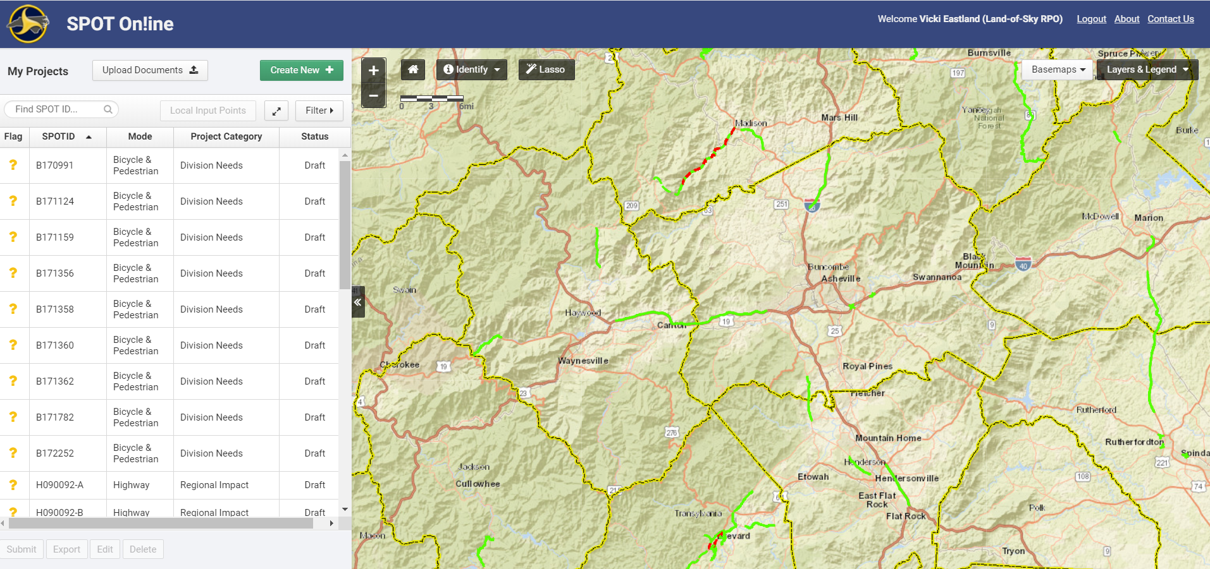
NCDOT Prioritization 7.0 AKA SPOT7.0
Vicki L. Eastland, Land of Sky Rural Planning Organization

Slide 36
What Is Prioritization and Why do we do it
The Prioritization Process (aka, SPOT) is the process in which the majority of funding decisions are made for transportation improvement projects.
North Carolina has a relatively unique process for prioritizing projects that is data-driven and transparent, as mandated by the Strategic Transportation Investments law (STI).
MPOs, RPOs, and NCDOT Divisions work together to develop and prioritize projects across the state with the goal of efficiently using transportation funds to enhance infrastructure while supporting economic growth and local needs.

Slide 37

How LOSRpo determines projects to submit
Division Engineers may also submit projects
Transylvania TAC & Municipalities
Buncombe County
Haywood County
Madison County & Municipalities
RPO TAC
It is preferred that projects are in a regionally or locally-adopted plan
Notes:
The first step, determining which projects are submitted into the prioritization process, is done differently by each MPO, RPO, and Division Engineer. For the French Broad River MPO, we meet with staff from every county and municipality (or the Transportation Advisory Committee in Henderson County) to determine what projects in long-range plans should be submitted. We also involve NCDOT Division staff at these meetings. Submissions are then taken to the MPO Board, are submitted for public comment, and then sent to NCDOT as the MPO’s official submissions.

Slide 38
Where Projects Come From
Comprehensive Transportation Plan (CTP)/Locally Adopted Plans
Prioritization (SPOT)
State Transportation Improvement Program (STIP)
Project Study and Implementation
Notes:
The first step, determining which projects are submitted into the prioritization process, is done differently by each MPO, RPO, and Division Engineer. For the French Broad River MPO, we meet with staff from every county and municipality (or the Transportation Advisory Committee in Henderson County) to determine what projects in long-range plans should be submitted. We also involve NCDOT Division staff at these meetings. Submissions are then taken to the MPO Board, are submitted for public comment, and then sent to NCDOT as the MPO’s official submissions.

Slide 39
How STI Works
Funding Tier | Statewide Mobility | Regional Impact | Division Needs
Quantitative Score | 100% of Total Score | 70% of Total Score | 50% of Total Score
RPO Score | 0% | 15% | 25%
Division Score | 0% | 15% | 25%
Percent of Available STI Funding | 40% | 30% | 30%
How the funds are Distributed | All Statewide Projects Compete Across the State (There are no Statewide Eligible Projects in Transylvania County) | Split Between 7 Regions (2 NCDOT Divisions) (Amount Based Population) Regional Competition | Split Equally Between 14 NCDOT Divisions. Projects Compete Within the Division.
Notes:
The first step, determining which projects are submitted into the prioritization process, is done differently by each MPO, RPO, and Division Engineer. For the French Broad River MPO, we meet with staff from every county and municipality (or the Transportation Advisory Committee in Henderson County) to determine what projects in long-range plans should be submitted. We also involve NCDOT Division staff at these meetings. Submissions are then taken to the MPO Board, are submitted for public comment, and then sent to NCDOT as the MPO’s official submissions.

Slide 40
How STI Works
Notes:
The first step, determining which projects are submitted into the prioritization process, is done differently by each MPO, RPO, and Division Engineer. For the French Broad River MPO, we meet with staff from every county and municipality (or the Transportation Advisory Committee in Henderson County) to determine what projects in long-range plans should be submitted. We also involve NCDOT Division staff at these meetings. Submissions are then taken to the MPO Board, are submitted for public comment, and then sent to NCDOT as the MPO’s official submissions.

Slide 41
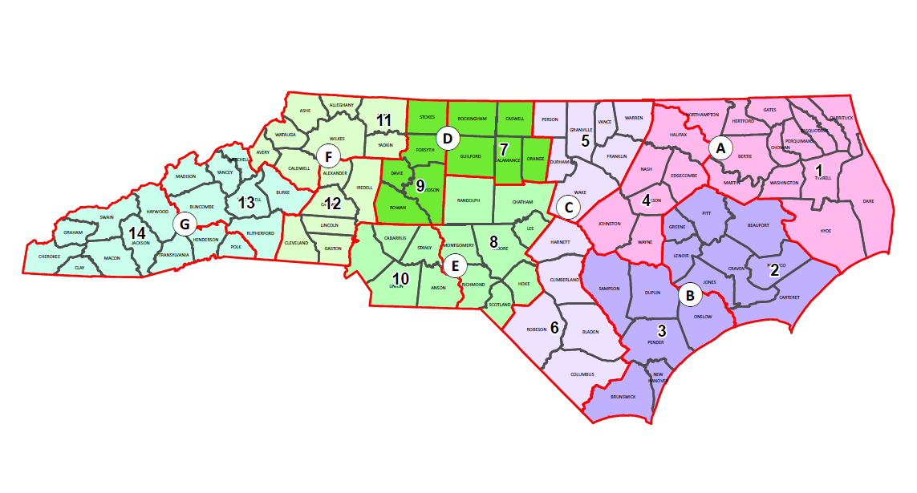
Regions and Divisions

Slide 42
Land of Sky RPO SPOT7.0 Details
Land of Sky RPO is allocated 15 Project Submittals in each Mode
  15 Highway
  15 Bike or Ped
  15 Public Transit
Land of Sky RPO also has 9 Carryover Highway Projects in this round
Land of Sky RPO receives 1,200 Local Input Points for Regional Impact
Projects and 1,200 Local Input Points for Division Needs Projects

Slide 43

Where we are Right Now
*** Projects that are submitted in the SPOT process will be under consideration for funding for the 2026-2035 State Transportation Improvement Program (STIP).
Notes:
The first step, determining which projects are submitted into the prioritization process, is done differently by each MPO, RPO, and Division Engineer. For the French Broad River MPO, we meet with staff from every county and municipality (or the Transportation Advisory Committee in Henderson County) to determine what projects in long-range plans should be submitted. We also involve NCDOT Division staff at these meetings. Submissions are then taken to the MPO Board, are submitted for public comment, and then sent to NCDOT as the MPO’s official submissions.

Slide 44
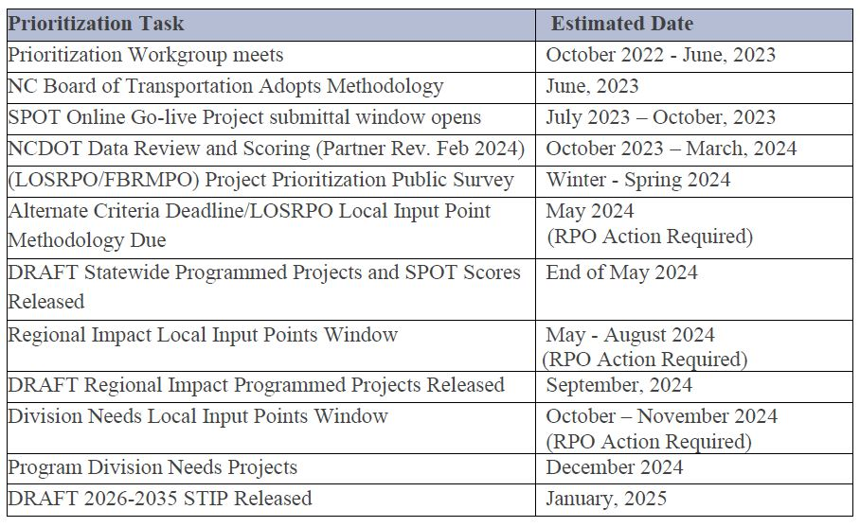
SPOT7.0 Updated Key Dates
We are Here

Slide 45
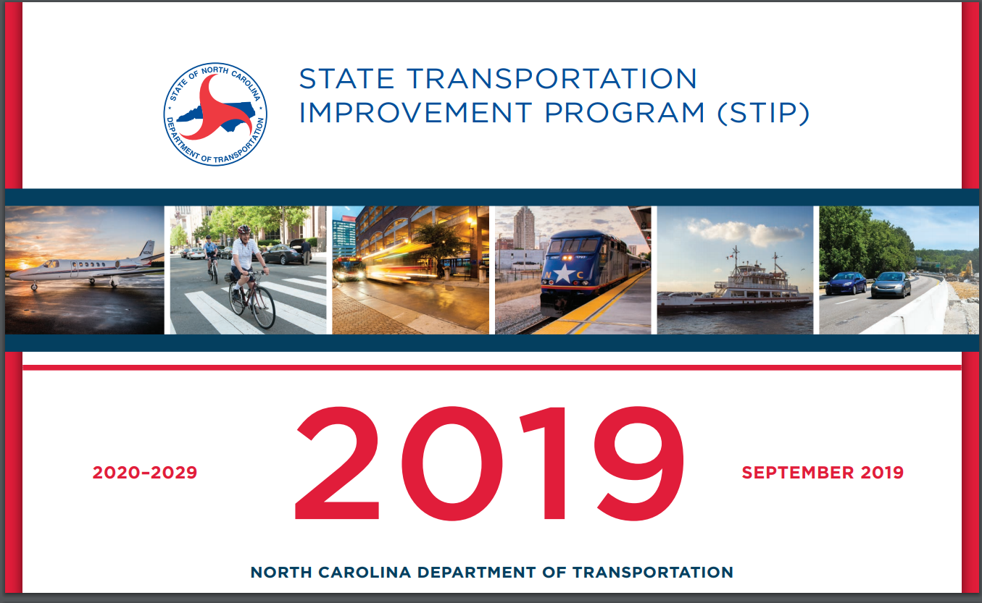
The Goal of the Process
2025
2026-2035
February 2025
Notes:
The first step, determining which projects are submitted into the prioritization process, is done differently by each MPO, RPO, and Division Engineer. For the French Broad River MPO, we meet with staff from every county and municipality (or the Transportation Advisory Committee in Henderson County) to determine what projects in long-range plans should be submitted. We also involve NCDOT Division staff at these meetings. Submissions are then taken to the MPO Board, are submitted for public comment, and then sent to NCDOT as the MPO’s official submissions.

Slide 46
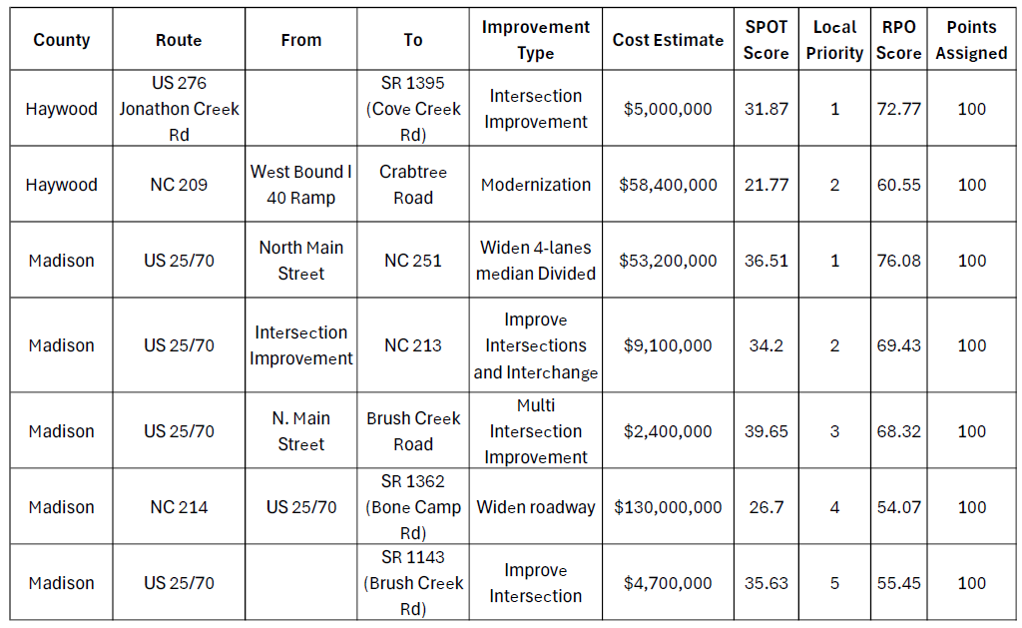

Slide 47
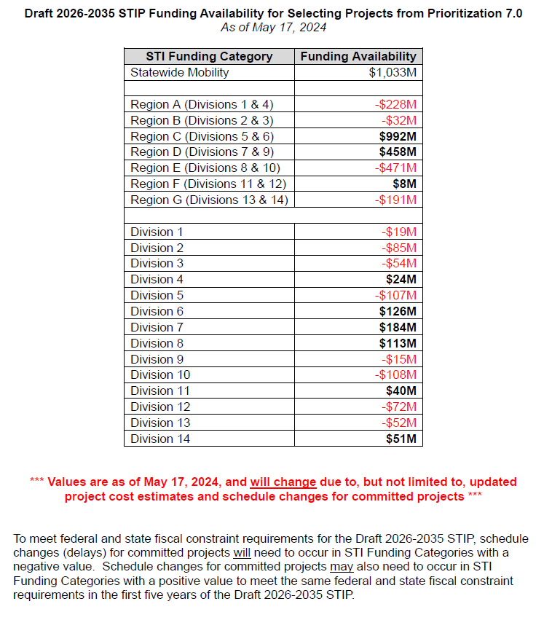

Slide 48
V-B. NCDOT Current Project Updates
Steve Williams, NCDOT, Division 14 Planning and Troy Wilson, NCDOT, Division 14, District 1 Engineer..
This is a routine update will provide the committee status updates for transportation projects that are already funded or are already under construction as they pertain to Transylvania County.

Slide 49
Quick Update on NCDOT Projects
Route/TIP # | Description | Completion Date | Completion %
US 64: R-57941, U-5104 | Caldwell St near Bracken Ln to US 64 near Brevard Academy | 6/25/23 *Revised Date: 10/21/2023 | 84%
US 64:R-5799 | Intersection of US-64/US-276 and US 280 (Asheville Hwy) | 5/14/2027 | 10%
US 64 | Resurfacing on Rosman Hwy and various secondary routes throughout TC | 10/15/2023 | 77%
SR-1309 | Bridge (#63) over West Fork of French Broad River on Silversteen Road | 5/15/2025 | 23%
SR-1615/HA-002 | Mountain Industrial Drive Road Extension in Jennings Industrial Park | 10/19/2024 | 27%
US 276: EB-5858 | Pedestrian Bridge across Davidson River | 4/11/2025 | 39%

Slide 50
STIP Updates NCDOT Projects
Project ID | Description | ROW ACQ Begins | Let Date
BN-0011 | Multi-use Path (Eastatoe Trail) from Cashiers Valley Road to US 64 |  | 2/11/2025
BP14.R012 | Replace B-5972 over tributary to Tucker Creek on Tanasee Gap Rd (SR 1324) | 1/9/21 & 1/13/20 | 1/25/2028
BP14.R022 | Replace Bridge #11 on Solomon Jones Rd (SR 1559) over Walker Creek | 2/11/2024 | 2/11/2025
BP14.R039 | Replace Bridge over French Broad River on Old Turnpike Rd | 11/11/2024 | 11/11/2025
BR-0252 | Replace Timber Bridges: Bridge over Walker Creek on Haskell Jones Rd, Bridge over Richland Creek on Homer McCall Rd, Bridge over Shoal Creek on Babb Rd | 1/30/2024 | 12/15/2024
HB-0026 | Replace Bridge Over French Broad River on Everett Rd | 5/15/2024 | 10/19/2027
EB-6037B | Ecusta Rail Trail | 9/30/2021 | FY 2026
R-5763 | Upgrade roadway: Wilson Road from Old US 64 to US 276 | 3/21/2022 | 9/16/2025
R-5800 | US 64 from US 276, Fortune Cove Rd to Caldwell Street. Construct median and access control measures. | 3/1/2023 | 10/20/2026
R-5865 | Widening to 3-lanes to include Bicycle lanes on US 276 from US 64 to Avery Creek Trail Head | 1/1/2040 | 1/1/2040
R-5882 | Improving Intersection of US 64/Broad St, US 64 BUS/Caldwell St, N. Country Club Rd | 7/21/2028 | PE Only
R-5919 | Modernize Roadway of US 178/East Main Street at Main Street in Rosman to Middlefork Off-site Parking | 10/12/2028 | PE Only
HF-0004 | US 276, Install guardrail from Sliding Rock to Proposed off-site parking, construct sidewalk |  | 9/22/2026

Slide 51
STIP Updates NCDOT Projects
Project ID | Description | ROW ACQ Begins | Let Date
HS-2014M | Install Pedestrian Signals, Crosswalk, Curb Ramps, and short segment of sidewalk on US 64/Asheville Hwy at Hospital Drive/Strauss Parkway |  | 6/25/2024
HS-2014AC | Install Traffic Signal with Pedestrian Signals at US 276/Greenville Hwy and Gallimore Rd |  | 8/27/2024

Slide 52
V-C. Comp. Transportation Plan Update
Update from Vicki Eastland and/or Daniel Sellers on the current progress of the Comprehensive Transportation Plan for Transylvania County.
Still in the draft process and waiting on final approval.

Slide 53
Public Comment
15-minute time limit
For those who wish to speak, please sign in on the sheet at the front.
Each speaker is limited to 3 minutes
​

Slide 54
Board Member Comments

Slide 55
Thank you

