Slide 1
TAC
Tuesday, April 13, 2021 @ 7pm

Slide 2
Public Comment
To allow recommended social distancing practices, public comment can be submitted by email or physical mail prior to each Planning Board meeting.
Arrangements can also be made for those wishing to speak in public comment to call in and speak via conference call.
Speakers are limited to three minutes.
The public comment period will close when there are no more speakers, or the 15-minute limit is reached.
Public Comment will also be taken at the end of the meeting.

Slide 3
Agenda Modifications

Slide 4
Consent Agenda
All items under the Consent Agenda are recommended for approval.
        Minutes
          October 13th, 2020

Slide 5
Presentations/Recognitions
Transylvania County Fixed Route Service

Slide 6
Presentations/Recognitions
Transylvania County Fixed Route Service

Slide 7

April Alm, Transportation Planner
Transylvania County Public Transportation
106 East Morgan Street, Suite 205
Brevard, NC 28712
Phone: (828) 884-3203, Option 2
Fax: (828) 884-4199
transport@tconc.org

Slide 8
Demand Response
Transylvania County Public Transportation provides demand response – door-to-door transportation services by appointment. Riders may call by 10:00 AM the day before to request transportation. This service is operation Monday through Friday, 7:00 AM until 5:00 PM. Currently, Transylvania County Transportation has five vans in operation, three lift vans and 2 non-lift vans. This Demand Response service is $1.00 per stop with up to three (3) stops. Riders may also qualify for a funding program where they may not pay a fare, for example, clients over 60 or disabled. Subscription type appointments may also be scheduled based on availability.
A demand response system is one where passenger trips are generated by calls from passengers for advanced scheduling and then the transportation system dispatches a vehicle to pick the passengers up and transport them to their destinations.

Slide 9
Contract Services
Transylvania County Transportation also contracts with a private service operator, Brevard City Cab, LLC which provides a round trip fare of $5.00 with up to 3 stops within Transylvania County. Since FY2019, through 5310 funding, Transylvania County Transportation, has been able to create a dedicated program for subsidized privately operated transit for individuals who are 65+ or have a disability for two purposes: to provide access to underserved rural areas in Transylvania County for individuals to travel from unincorporated area to the City of Brevard or Town of Rosman and secondly to provide reliable Transportation services to Buncombe and Henderson County.

Slide 10
Fixed Route
The new fixed route service that began on January 4, 2021 connects Rosman to Brevard to Pisgah Forest, operating Monday through Friday, 6:30 AM until 5:00 PM. A Saturday service will be introduced at a later date operating from 10:00 AM until 2:00 PM. Regular service routes have been established based on demand response destination data. The cost of the fixed route service is $1.00 per stop with the ability to purchase a book of 20 Tickets for $15.00 and an unlimited monthly pass for $30.00. Riders will have purchase options through the driver or Transportation office.
A fixed route is a transit service where vehicles run on regular, scheduled routes with fixed stops and no deviation. Typically, fixed-route service is characterized by printed schedules or timetables and designated bus stops where passengers board and descend.

Slide 11
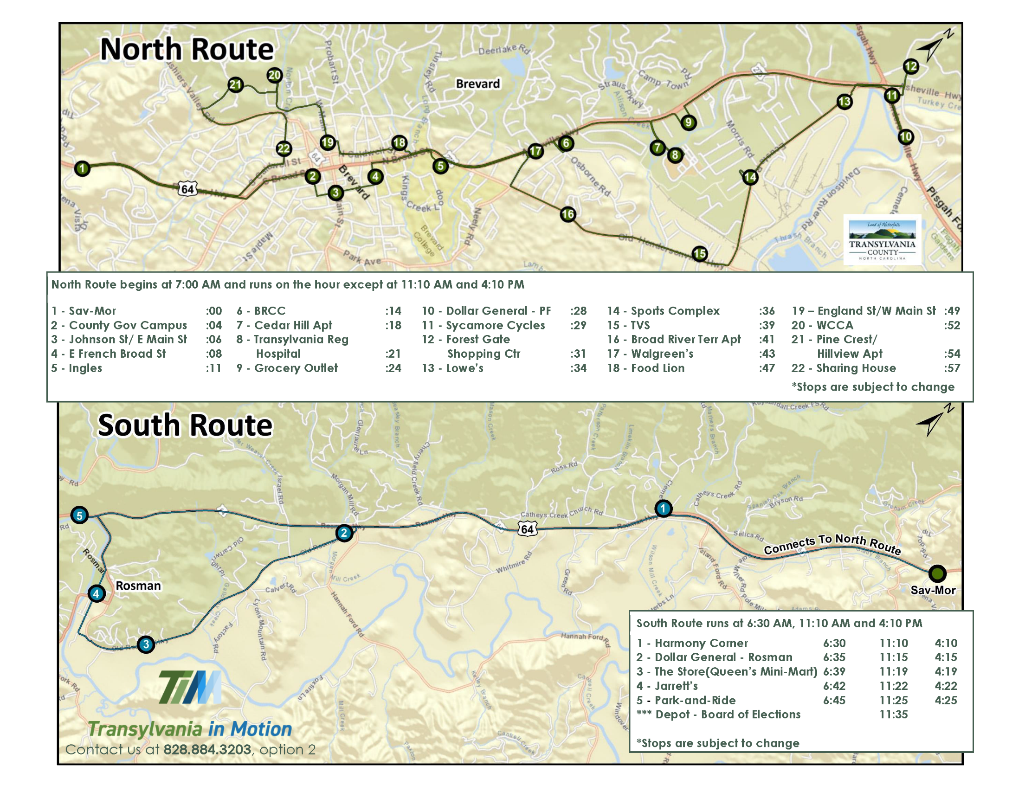

Slide 12
Statistics
Transylvania County’s Transportation service area demographics represent 37% elderly, 16% disabled, 8.8% minority and 14.7% of Transylvania County residents are below poverty level (Census.gov: 2018 American Community Survey 5-Year Estimates).
587 households (4.2%) in Transylvania County had no vehicles available and 4,284 households had one vehicle.
Goals
  Explore expansion of van service in underserved areas of County
      Going further into rural areas where van transportation is currently unavailable
      Creating grocery store and shopping trips on designated days during the week
  Analyze ways to connect van service with Henderson County and Buncombe County
  Evaluate the extension of the demand response service to evenings and Saturdays
  Investigate a partnership with local medical providers funding transportation for rural citizens to medical appointments

Slide 13
New Business
CTP and STIP - Update
NCDOT Project Update
Director’s Report

Slide 14
CTP and STIP - Update
  Background
    Vicki Eastland
      RPO Coordinator
      Economic and Community Development
      (828)251-7450
      vicki.eastland@landofsky.org

Slide 15
New Business
CTP and STIP - Update
NCDOT Project Update
Director’s Report

Slide 16
NCDOT Project Update
  Background

Slide 17
New Business
CTP and STIP - Update
NCDOT Project Update
Director’s Report

Slide 18
Director’s Report
  Next Meeting
    Tuesday, July 13th, 2021 at 7:00 PM
  Expiring Terms
    Dr. John R. Folger Jr.,
      2nd Term, June 1st, 2018 – May 31st, 2021
    David Carter
      4th Term, June 1st, 2018 – May 31st, 2021

Slide 19
Public Comment

Slide 20
Committee Members’ Comments

Slide 21
Adjournment
Thank you for attending!

